Slide 1
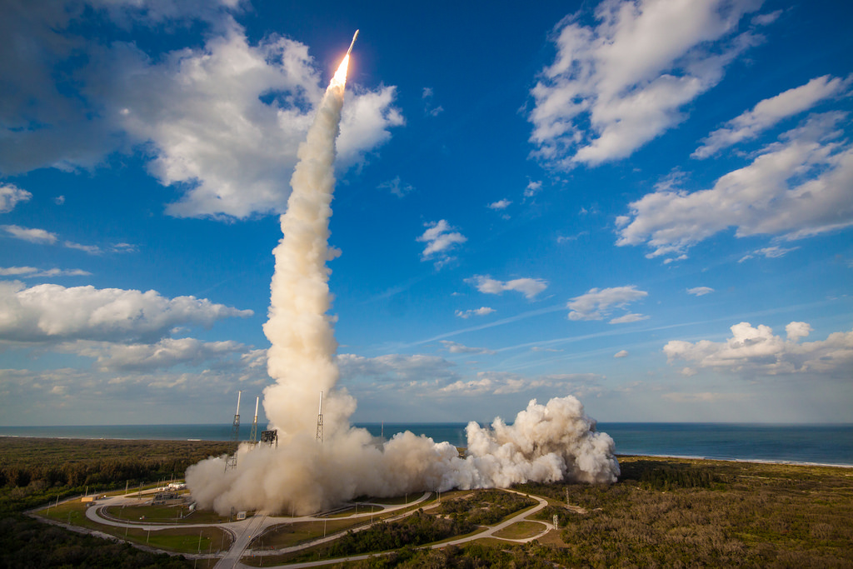
Welcome to GOES-17 OTRR
Peer Stakeholder-Product Validation Review (PS-PVR) for the
Full Validation Maturity of GOES-17 ABI L1b Products
GOES-R Calibration Working Group, 12 February 2020

Slide 2
Acknowledgements
Current CWG Members: F. Yu, V. Kondratovich, H. Yoo, H. Qian, and S. Guo.
Former CWG Members: C. Cao, F. Padula, A. Pearlman, D. Pogorzala, R. Datla, X. Shao, M. Grotenhuis, M. Chu, B. Efremova, R. Iacovazzi, L. Zhu, J. Choi, and R. Mirza-Saliq, and Z. Wang.
External Members: T. Schmit, M. Gunshor, D. Lindsey, Steve Miller, M. Coakley, M. Black, J. Douglas, K. Mitchell.
Instrument and Ground Vendors: W. Harting, J. Van Naarden, D. Gall, L. Roop, M. Wilson, and A. Tipping.
GOES-R Program for technical, administrative, and financial support: C. Rollins, A. Reth, Z. Li, M. Weinreb, J. Fulbright, E. Kline, K. Pitts, W. Lebair, J. Kronenwetter, M. Seybold, E. Grigsby, S. Goodman, C. Keeler, A. Krimchansky.
STAR Colleagues for feedback, web, administrative, contract, financial support: J. Daniels, AWG leads, L. Brown, S. Kalluri, etc.
And many more.
Notes:
All: missed anyone?

Slide 3
Outline
Introduction.
Performance at and since Provisional with stable FPM temperature.
Overview of PLPTs.
  Briefed in detail at the CWG Meetings (Jan 29, Feb 5 & 12).
  Will flash through the Quart Charts.
Major activities and achievements since Provisional.
Performance with unstable FPM temperature
Remaining issues and path forward
Assessment of maturity
Summary and recommendations.
Notes:
All: missed anyone?

Slide 4
Performance Overview

Slide 5
Submitted Results
Performance Summary was submitted in a spreadsheet with 13 tabs
1. Geometric Calibration
 | a. Navigation Error
 | b. Registration Error – Channel-to-Channel (CCR)
 | c. Registration Error – Pixel-to-Pixel Within Frame (WIFR)
 | d. Registration Error – Frame-to-Frame (FFR)
2. Radiometric Calibration
 | a. Noise
 | b. Precision
 | c. Repeatability
 | d. Accuracy
 | e. Dynamic Range
 | f. Radiometric Drift
 | Linearity

Slide 6
Stable FPM Temperature
 | VNIR | IR
Noise | Meet the MRD. Channels 4-6 failed the Baseline. Comparable with GOES-16 ABI. No significant change since Provisional. | Seriously compromised by the LHP anomaly. Meet the waived MRD except for Channels 15 & 16 (within 10% of MRD). No significant change since Provisional.
Accuracy | Meet the MRD. Improved since Provisional B02: LUT update. B05: Latch-up correction. | Meet the MRD except for Channel 16. SRF update (in work) will meet the MRD. No significant change since Provisional.

Slide 7
Unstable FPM Temperature
 | VNIR | IR
Noise | Did not analyze separately. | Waived. Increased (doubled for some) with Gain Set III and 81K. Increased further with rising FPM temperature, leading to saturation for some channels.
Accuracy | No significant impact. Affects stability that will be addressed later. | Some radiance become invalid when MRD is waived. Most valid data meet the MRD. Some valid data may have larger bias due to SRF change at higher FPM temperature (insufficient data to confirm).
More details (repeatability, dynamic range, coherent noise, etc.) were provided separately and can be discussed at request.

Slide 8
VNIR Noise
Mean (not the min) NEdT meets MRD for all channels.
Channels 4-6 min SNR is always worse than the Baseline for both ABIs.
Mean SNR are consistent for both ABIs over time.

Slide 9
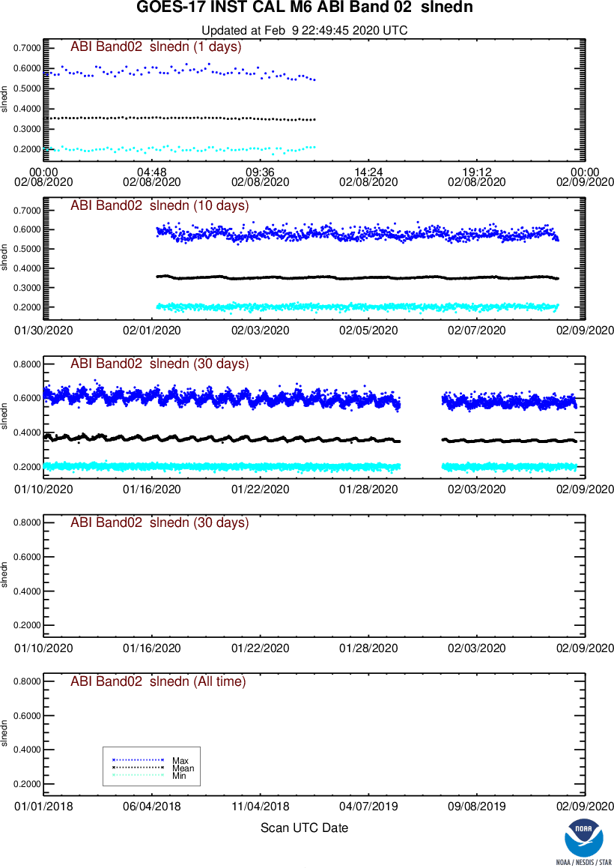
VNIR Noise Stability
Stable.
Results for other channels are at https://www.star.nesdis.noaa.gov/GOESCal/index.php

Slide 10
VNIR Accuracy
Channel 2 correction.
SCT space count latch up.

Slide 11
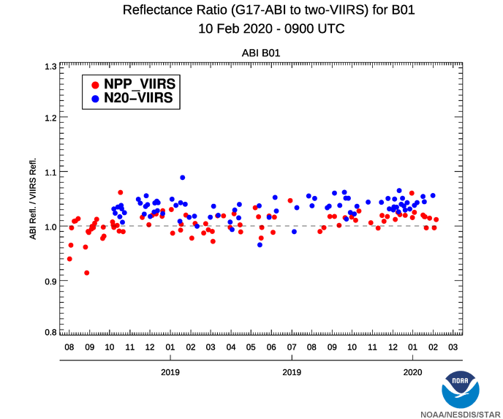
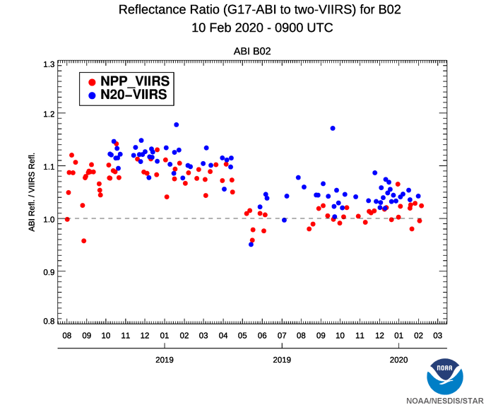
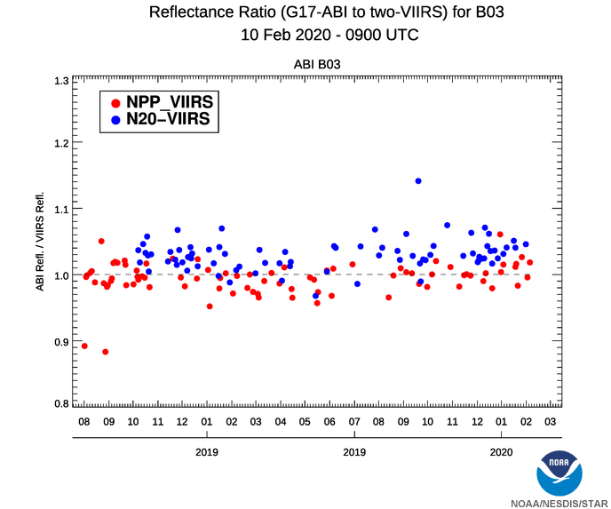
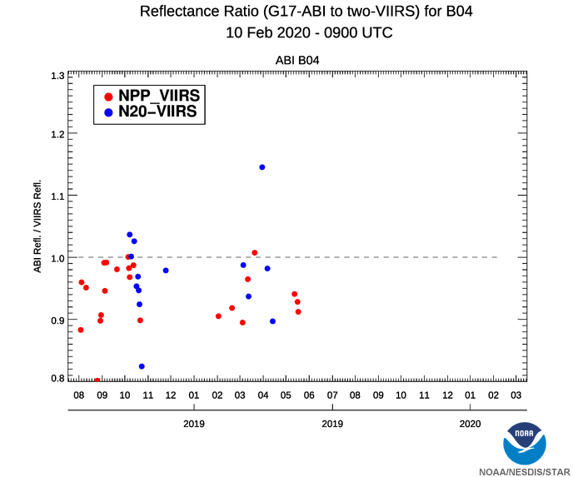
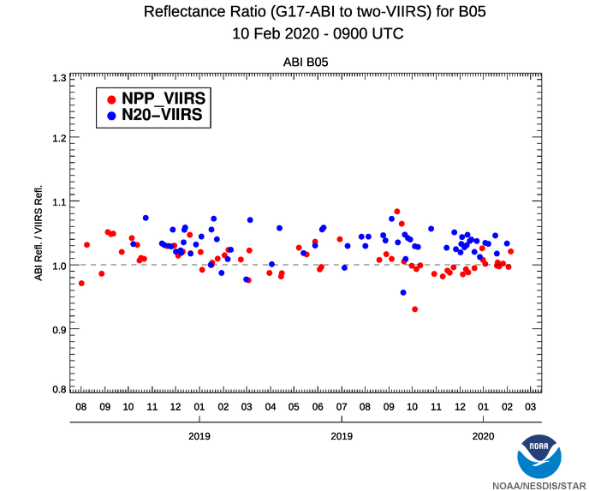
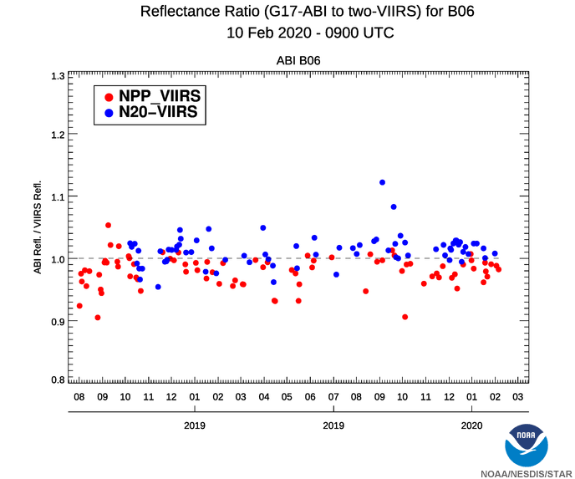
VNIR Accuracy Stability
More results are at https://www.star.nesdis.noaa.gov/GOESCal/index.php

Slide 12
IR Noise (Cool)
Channels 7, 8, 9, 10, and 12 is worse than the Baseline. Channels 15 & 16 do not meet the MRD.
Up to twice as worse with Gain Set III at the same when FPM is at 81K.
  Even worse with higher FPM temperature (saturated).
This is one of the most direct and serious consequences of LHP failure.

Slide 13
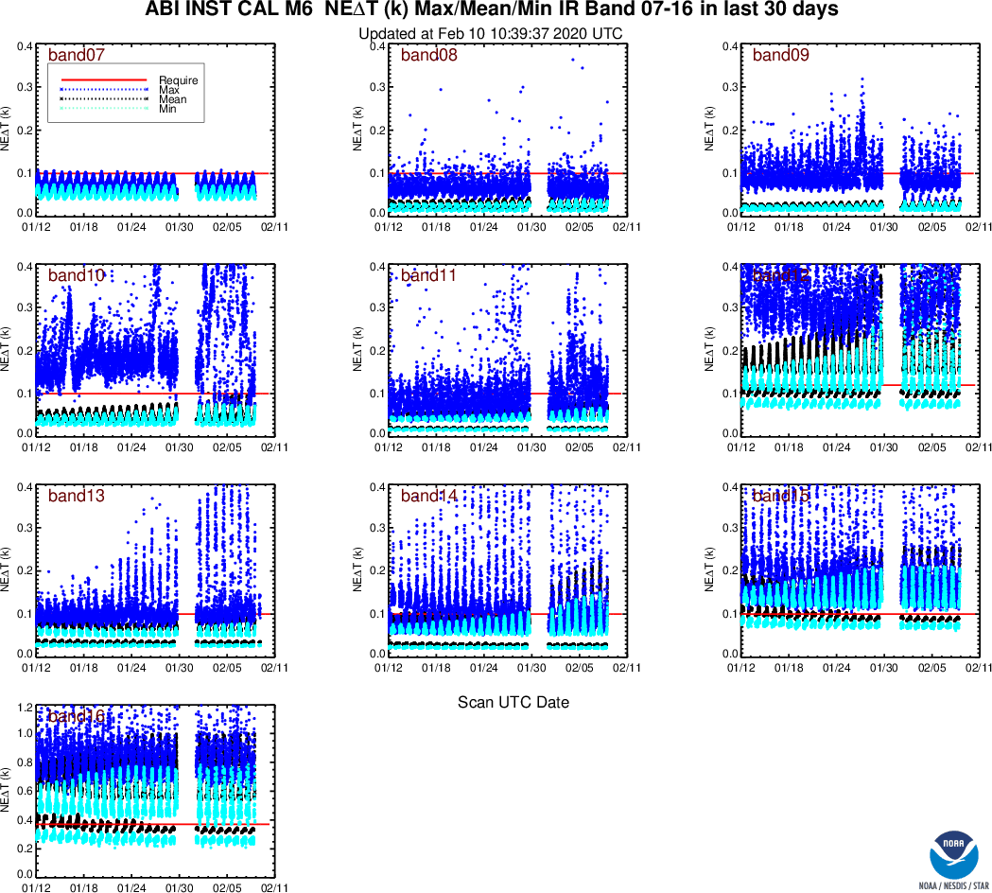
IR Noise Stability (Cool)
Stability is not expected, especially for the maxima.
Variation of the means and minima can be explained by the daily and seasonal changes of FPM temperature and the gain set.
Normal, considering the circumstances.
More results are at https://www.star.nesdis.noaa.gov/GOESCal/index.php

Slide 14
IR Accuracy
G16 did not benefit from all bias correction at Full Validation
  Bias < 0.1K now for nearly all channels.
G17 LHP anomaly does not affect bias.
  But the uncertainty of bias is larger in general.
  SRF has not been updated.

Slide 15
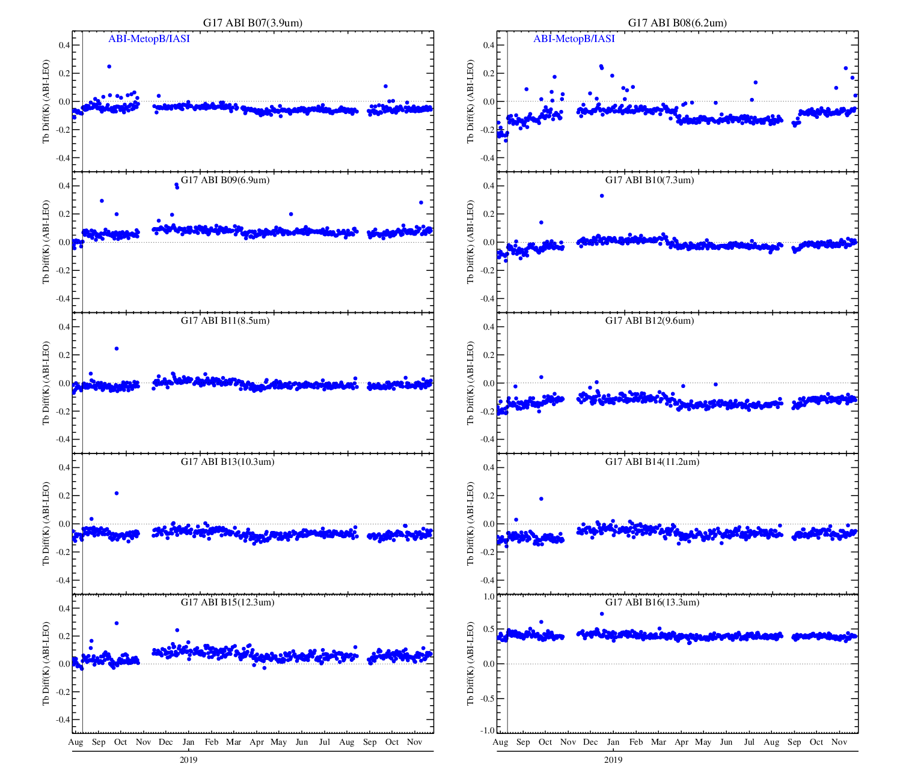
IR Accuracy Stability
More results are at https://www.star.nesdis.noaa.gov/GOESCal/index.php

Slide 16
INR Performance Summary
All meet the MRD, often with large margin.
Most performed consistently with the Baseline.
  CCR: 064-390 failed the Baseline.
  WIFR: Only 064 & 086 meet the Baseline.
In general, perform better than at Provisional and comparable with G16 at Full Validation.
Little noticeable impacts of LHP anomaly on INR performance.
Benefited from GOES-16 and continue to improve.
More details (during eclipse, other WIFR, MTF, etc.) were provided separately and can be discussed at request.

Slide 17
Navigation Accuracy
Requirement
Meet the MRD and the Baseline with large margin.
Perform better than at Provisional and comparable with G16 at Full.
GOES-16 Provisional results are not shown (2-3 times of MRD for many channels)

Slide 18
Channel-To-Channel Registration (CCR)
With minor exceptions, all meet the MRD (and the Baseline) with large margin.
Perform better than at Provisional and comparable with G16 at Full.
Exception: 064-390 meet the MRD but not the Baseline.
  Similar to G16 at Full and G17 at Provisional.
No noticeable impact of LHP anomaly.

Slide 19
Frame-To-Frame Registration (FFR)
All meet the Baseline, with substantial margins.
Comparable to G16 at the same stage. No noticeable impact by LHP anomaly.
Perform better than at Provisional.

Slide 20
Within Frame Registration (WIFR)
All meet the MRD. 064 & 086 also perform consistently with the Baseline.
Comparable to G16 at the same stage. No noticeable impact by LHP anomaly.
Consistent with Provisional performance.

Slide 21
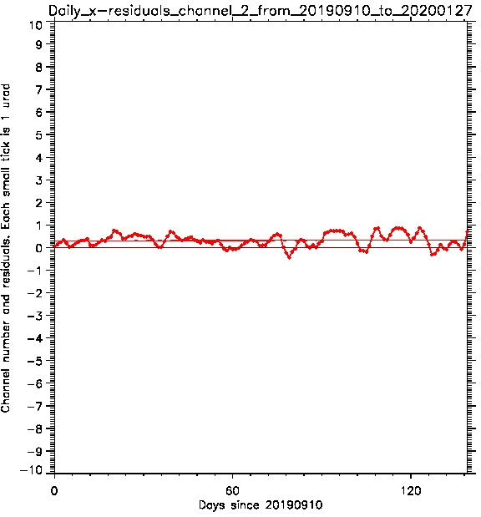
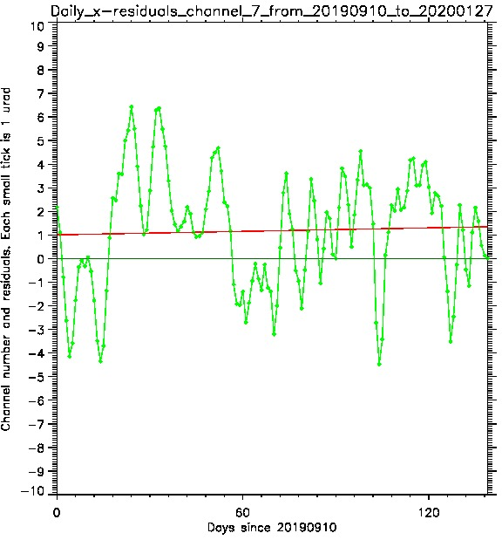
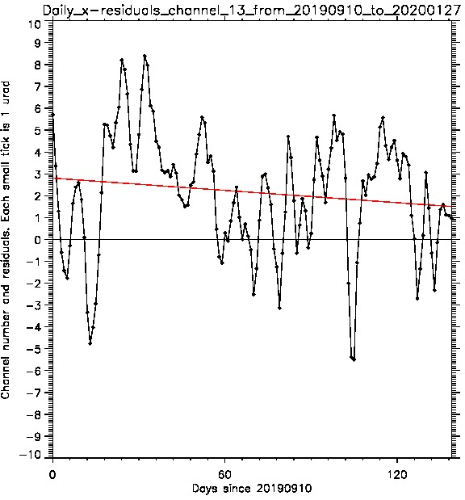
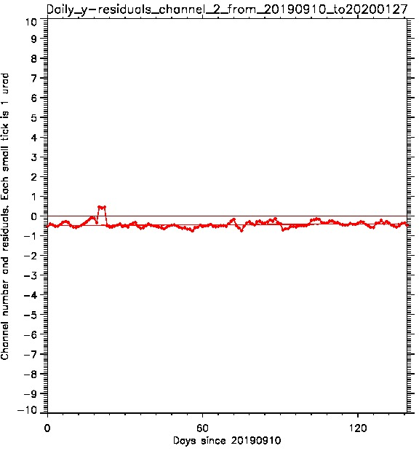
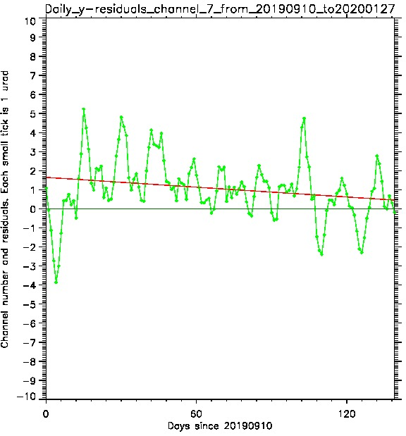
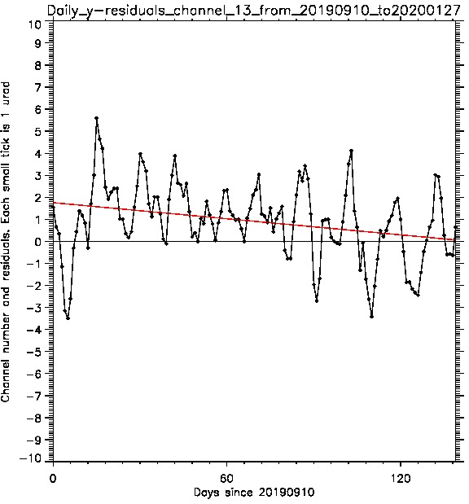
INR Stability – Linear Trend
ABI/G17 Linear Trending Plots – Ch.2,7,13, Last Period
Notes:
Legend: ABI daily average residual STDs in the EW (left) and NS (right) directions. Empty spaces are data gaps.
Discussion: Change in the daily STD is indiscernible on the oscillating background. The NWIR and LWIR STDs are larger.

Slide 22
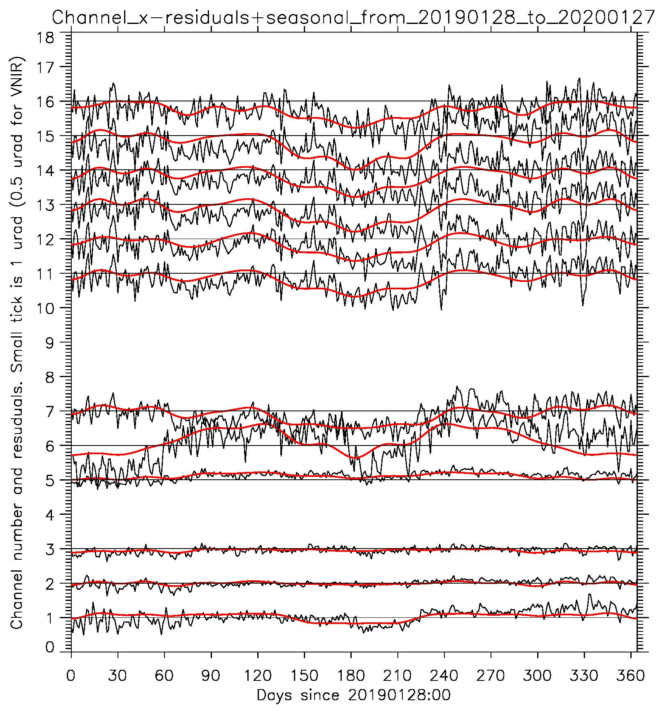
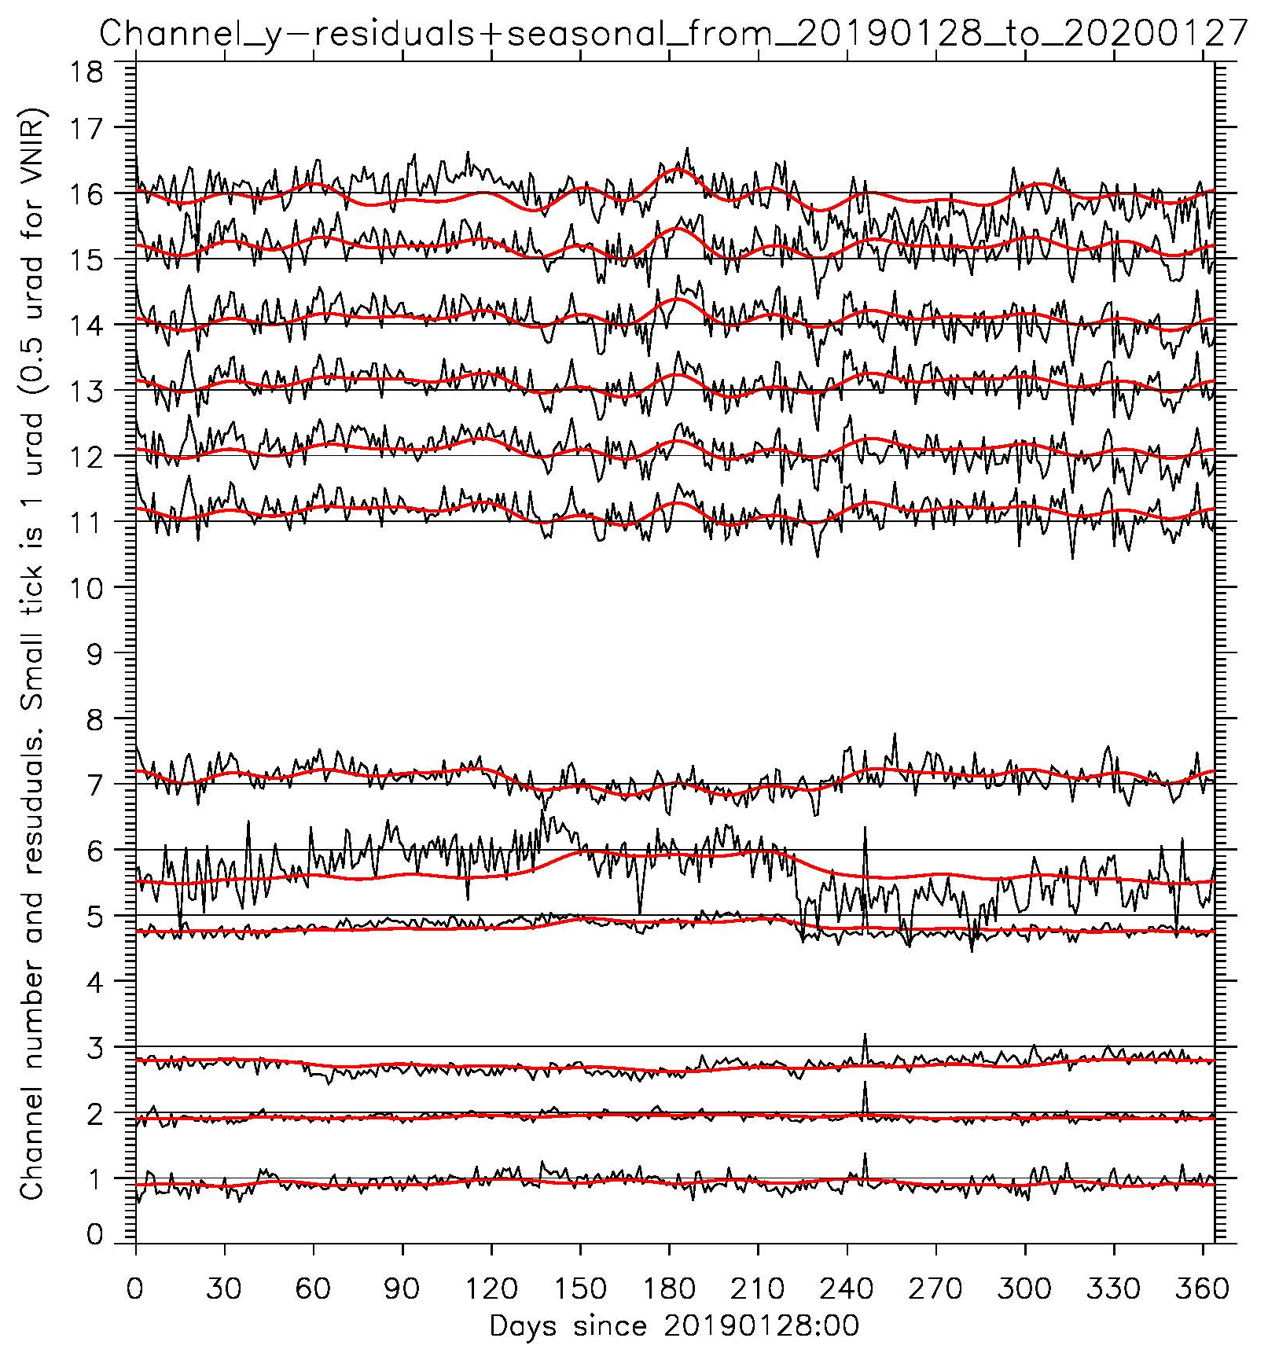
INR Stability – Seasonal Variation
ABI/G17 1-Year Daily Residuals And The Sum Of Harmonics
Notes:
Legend: ABI daily average residual STDs in the EW (left) and NS (right) directions. Empty spaces are data gaps.
Discussion: Change in the daily STD is indiscernible on the oscillating background. The NWIR and LWIR STDs are larger.

Slide 23
Post-Launch Product Tests (PLPT)

Slide 24
PLPT for GOES-16 ABI
Test ID | Short Title
ABI-L1b-PLPT-001 | IR Validation IASI CrIS
ABI-L1b-PLPT-002 | IR Validation CRTM
ABI-L1b-PLPT-003 | ZRDQ Performance
ABI-L1b-PLPT-004 | VNIR Validation VIIRS
ABI-L1b-PLPT-005 | VNIR Validation Sonora
ABI-L1b-PLPT-006 | VNIR Validation RVS
ABI-L1b-PLPT-007 | Monitoring
ABI-L1b-PLPT-008 | AD Converter
ABI-L1b-PLPT-009 | Low Light SNR
ABI-L1b-PLPT-010 | Image Navigation
ABI-L1b-PLPT-011 | Image Registration
ABI-L1b-PLPT-012 | Image Stitching
ABI-L1b-PLPT-013 | VNIR Validation DCC
ABI-L1b-PLPT-014 | Detector Uniformity Stability NSS
ABI-L1b-PLPT-015 | Validation SNO NSS
ABI-L1b-PLPT-016 | L2 Validation Support NSS
ABI-L1b-PLPT-017 | Lunar NSS
ABI-L1b-PLPT-018 | Detector Uniformity
ABI-L1b-PLPT-019 | Initial Solar Calibration
ABI-L1b-PLPT-020 | IR Spatial Uniformity
Test ID | Short Title
ABI-L1b-PLPT-021 | SRF Verification
ABI-L1b-PLPT-022 | OOB Response
ABI-L1b-PLPT-023 | Polarization
ABI-L1b-PLPT-024 | Cal-to-Cal Repeatability
ABI-L1b-PLPT-025 | Linearity
ABI-L1b-PLPT-026 | Ghosting
ABI-L1b-PLPT-027 | Field Campaign – Aircraft
ABI-L1b-PLPT-028 | Field Campaign – Surface
ABI-L1b-PLPT-029 | VNIR Verification – Rayleigh
ABI-L1b-PLPT-030 | VNIR Verification – Uyuni
ABI-L1b-PLPT-031 | BDS
ABI-L1b-PLPT-032 | VNIR SNR & Dynamic Range
ABI-L1b-PLPT-033 | IR Cal Stability
ABI-L1b-PLPT-034 | MTF
ABI-L1b-PLPT-035 | Coherent Noise
ABI-L1b-PLPT-036 | IR NEdT & Dynamic Range

Slide 25
PLPT for GOES-17 ABI
Test ID | Short Title
ABI-L1b-PLPT-001 | IR Validation IASI CrIS
ABI-L1b-PLPT-002 | IR Validation CRTM
ABI-L1b-PLPT-003 | ZRDQ Performance
ABI-L1b-PLPT-004 | VNIR Validation VIIRS
ABI-L1b-PLPT-005 | VNIR Validation Sonora
ABI-L1b-PLPT-006 | VNIR Validation RVS
ABI-L1b-PLPT-007 | Monitoring
ABI-L1b-PLPT-008 | AD Converter
ABI-L1b-PLPT-009 | Low Light SNR
ABI-L1b-PLPT-010 | Image Navigation
ABI-L1b-PLPT-011 | Image Registration
ABI-L1b-PLPT-012 | Image Stitching
ABI-L1b-PLPT-013 | VNIR Validation DCC
ABI-L1b-PLPT-014 | Detector Uniformity Stability NSS
ABI-L1b-PLPT-015 | Validation SNO NSS
ABI-L1b-PLPT-016 | L2 Validation Support NSS
ABI-L1b-PLPT-017 | Lunar NSS
ABI-L1b-PLPT-018 | Detector Uniformity
ABI-L1b-PLPT-019 | Initial Solar Calibration
ABI-L1b-PLPT-020 | IR Spatial Uniformity
Test ID | Short Title
ABI-L1b-PLPT-021 | SRF Verification
ABI-L1b-PLPT-022 | OOB Response
ABI-L1b-PLPT-023 | Polarization
ABI-L1b-PLPT-024 | Cal-to-Cal Repeatability
ABI-L1b-PLPT-025 | Linearity
ABI-L1b-PLPT-026 | Ghosting
ABI-L1b-PLPT-027 | Field Campaign – Aircraft
ABI-L1b-PLPT-028 | Field Campaign – Surface
ABI-L1b-PLPT-029 | VNIR Verification – Rayleigh
ABI-L1b-PLPT-030 | VNIR Verification – Uyuni
ABI-L1b-PLPT-031 | BDS
ABI-L1b-PLPT-032 | VNIR SNR & Dynamic Range
ABI-L1b-PLPT-033 | IR Cal Stability
ABI-L1b-PLPT-034 | MTF
ABI-L1b-PLPT-035 | Coherent Noise
ABI-L1b-PLPT-036 | IR NEdT & Dynamic Range
ABI-L1b-PLPT-037 | Stray Light During Solar Calibration
ABI-L1b-PLPT-038 | Lunar Calibration
Critical tests.
Consolidated tests.
Eliminated tests.
Nominal tests.

Slide 26
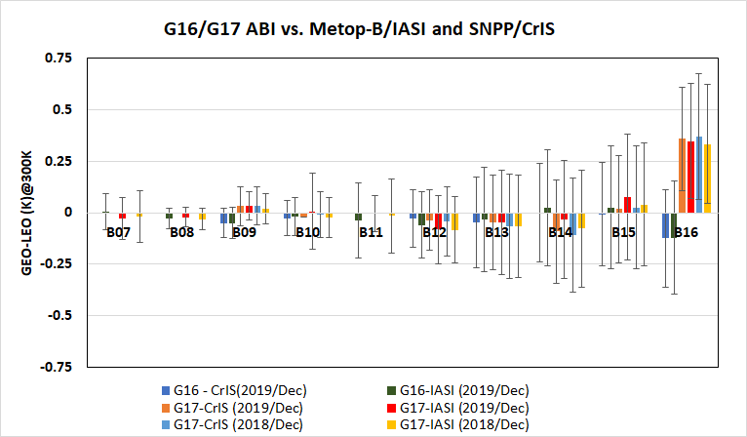
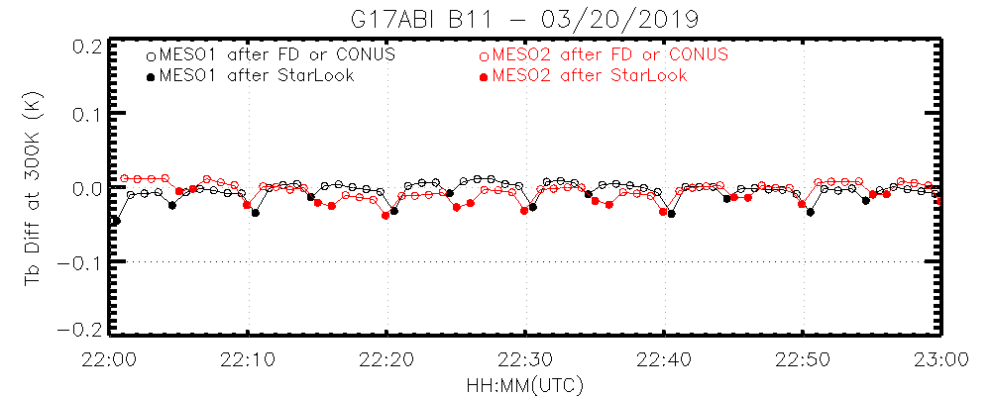
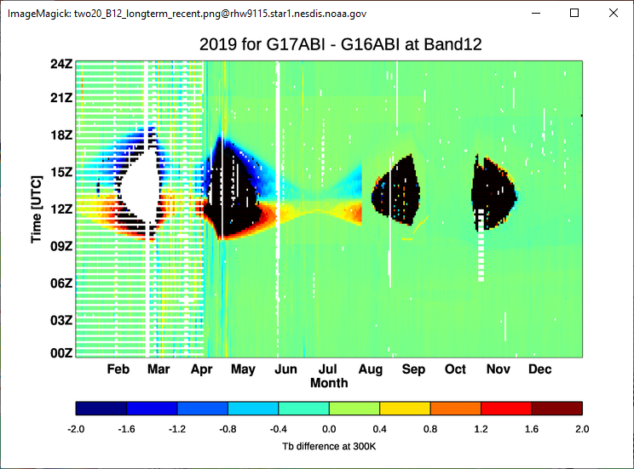
ABI-L1b-PLPT-001
IR Validations
Methodology
Validate the IR calibration accuracy at various temporal scales
GEO-LEO Inter-Calibration for absolute calibration accuracy assessment
Relative calibration accuracy:
  Diurnal variation: GEO-GEO Inter-comparison and GEO-LEO Inter-calibration
  Swath-to-Swath/MESO-to-MESO variation: MESO radiance variations
Objective
Validate radiometric calibration accuracy of the thermal emissive bands
Related Requirements
MRD 737, 1493, 1503, 1513, 2130, 519
Conclusion
During gainset = 1 period, G17 ABI IR radiance overall is well-calibrated and stable
  The mean bias for the full-disk images to CrIS/IASI is less than 0.1K for most IR bands, except for B16
  B16 Tb bias is ~0.35K at 300K. The new SRF at 81K will reduce the Tb bias
  Small seasonal variation, coincident with the spacecraft orientation periods, can be observed at certain IR bands.
The pCal algorithm significantly improves the radiometric calibration accuracy at the unstable IR FPM temperature period when earth radiance is available
  Reduced diurnal variation
Dark current variations after the star-looks results in lower MESO radiance
  Mode 6 Swath-to-Swath/MESO-to-MESO variations meet the waived requirements
Results
IR Bias of the full-disk images under the “Best” Conditions
Swath-to-Swath Variation
GEO-GEO Inter-comparison showing reduced diurnal variation
Completed

Slide 27
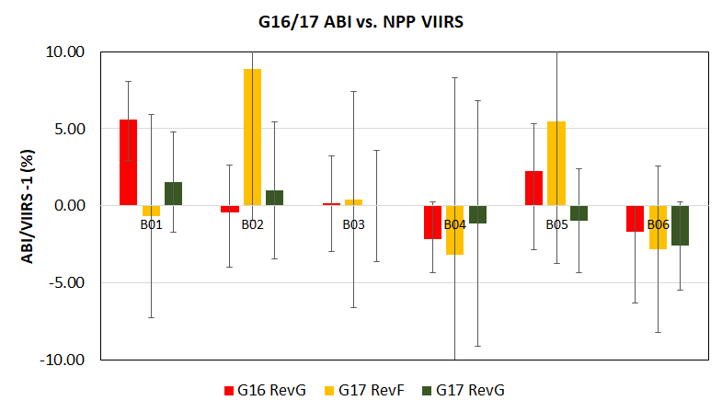
ABI-L1b-PLPT-004
VNIR Validation
Objective
Validate radiance accuracy of the VNIR bands using temporally and spatially coincident SNPP VIIRS VNIR data collected at the same viewing geometry
Related Requirements
MRD 737, 2120, and 2130
Method
GSICS Ray-matching method
Time difference: <5 minutes
Cosine of viewing zenith angle difference < 1%
Time: 17:00UTC-19:00UTC
Geolocation range: 1ºS < latitude < 1ºN
Azimuth angle difference: < 60°
Avoid of sun-glint impact
SRF adjustment
Uniform scenes
Results
Conclusion
After the series of calibration algorithms and parameters updates, the mean radiometric calibration difference to SNPP/VIIRS is less than 5% for the G17 VNIR bands.
  Reduced reflectance difference to NPP/VIIRS at B04-B06 with RevG algorithm implemented 4/8/2019
  B02 radiance is greatly reduced and comparable to SNPP/VIIRS after the solar-calibration LUT update on 04/27/2019
  No strong striping after the lunar intrusion look-up-table updates on 05/05/2019
Mean difference to G16 ABI is within 5% for each VNIR band
  Different version of Esun values for G16 and G17
Completed

Slide 28
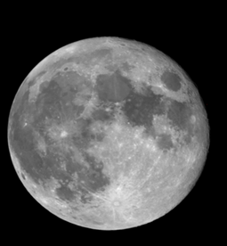
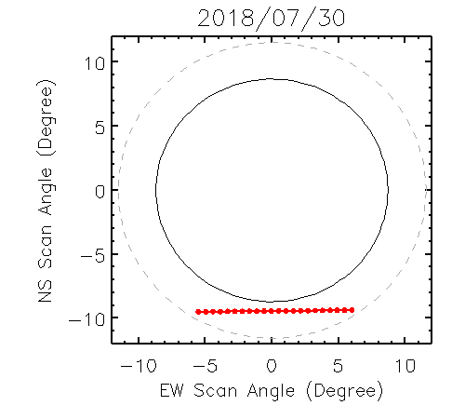
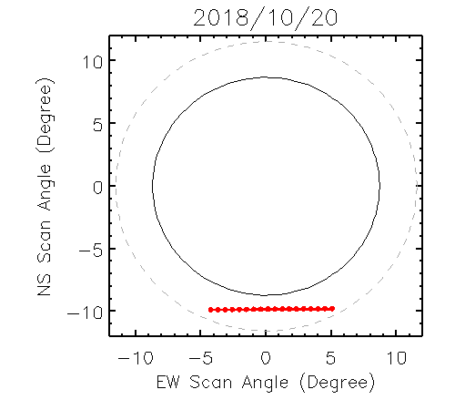
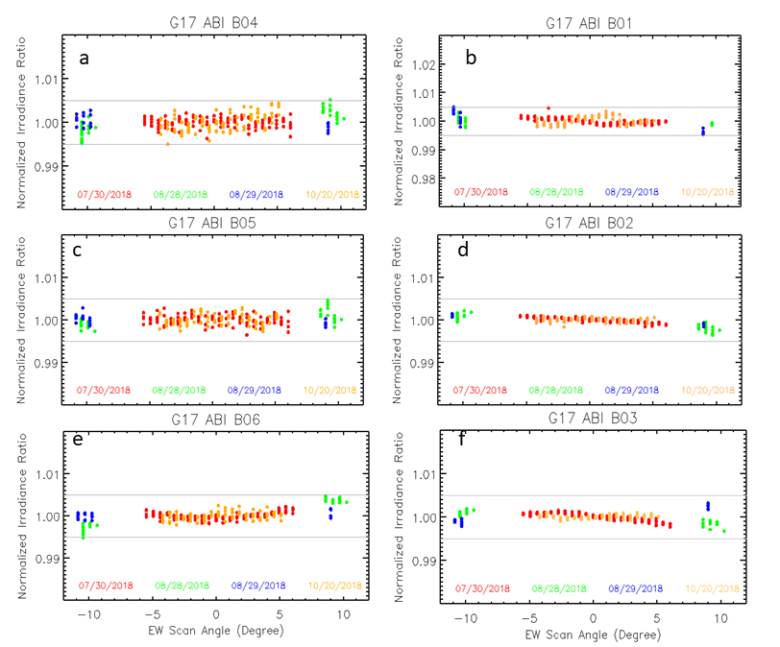
ABI-L1b-PLPT-006
VNIR Spatial Uniformity
Objective
Determine and validate scan mirror angle-dependent reflectivity corrections for the VNIR bands.
Related Requirements
MRD 2120
Method
Use of GIRO model to compensate for lunar irradiance variation for the lunar images collected as it transited across the ABI field of regard
Results
Conclusion
Lunar chasing events were successfully conducted on 07/30/2018 and 10/20/2018
After the straylight corrections at the lunar irradiance measurement, the East-West response versus scan-angle, as represented as the normalized ratio between the observed and simulated lunar irradiance, is less than 1% at all the VNIR bands.
Completed

Slide 29
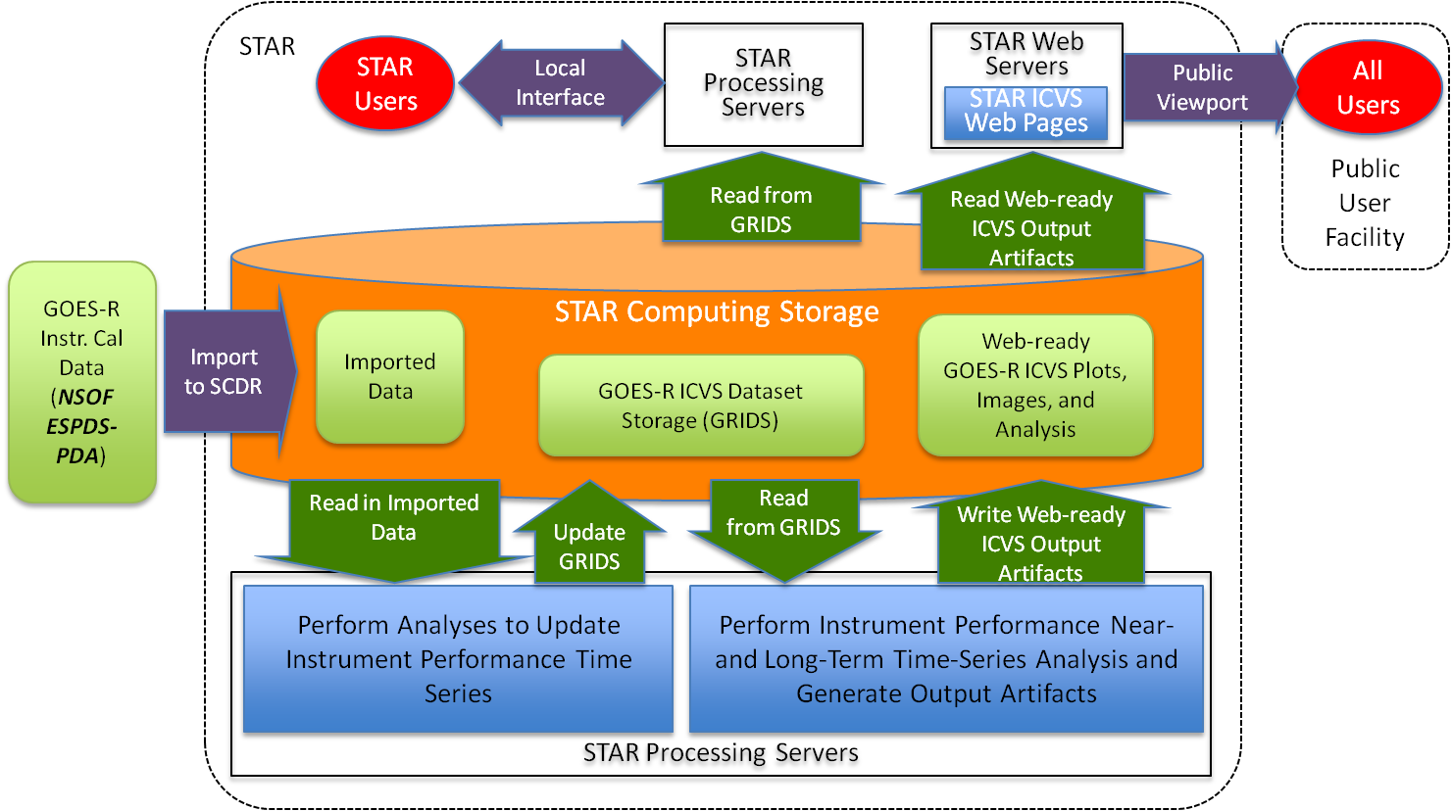
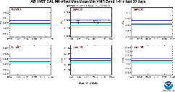
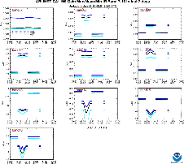
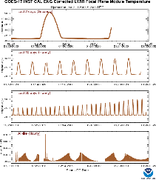
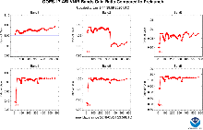
ABI-L1b-PLPT-007
Instrument Performance Monitoring
Objective
Method
Perform automated monitoring of G17 ABI instrument performance in all 16 bands, Engineering Telemetry and Solar Calibration in near-real time at the STAR designated GOES Calibration web site.
Related Requirements
MRD737 (Long-term radiance drift); MRD2120 (Solar calibration absolute accuracy); MRD-2121 and MRD-2158 (Calibration-to-calibration radiance precision); and MRD-2130 (Product monitoring).
Flow chart of ABI IPM processing
Results
Conclusion
CWG GOES-17 ABI IPM results can be found at the following links:
Instrument Calibration Performance
https://www.star.nesdis.noaa.gov/GOESCal/G17_ABI_INST_CAL_VNIR_daily_INT.php
https://www.star.nesdis.noaa.gov/GOESCal/G17_ABI_INST_CAL_daily_INT.php
Engineering Telemetry Performance https://www.star.nesdis.noaa.gov/GOESCal/G17_ABI_INST_CAL_ENG_daily_INT.php
Solar Calibration Performance https://www.star.nesdis.noaa.gov/GOESCal/G17_ABI_Solar_Cal_static.php
CWG provides automated monitoring of G17 ABI instrument performance in all 16 bands, Engineering Telemetry and Solar Calibration in near-real time.
This IPM provides valuable and timely supports for the calibration work in CWG group, helping in resolving the issues in the algorithm/LUTs update, major anomaly events, missing dataset etc.
Monitored data represents at least 95% of INST-CAL data available for processing and all G17 solar calibration.
VNIR bands
IR bands
Engineering Data
Solar Calibration
Completed

Slide 30
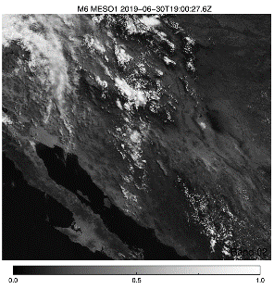
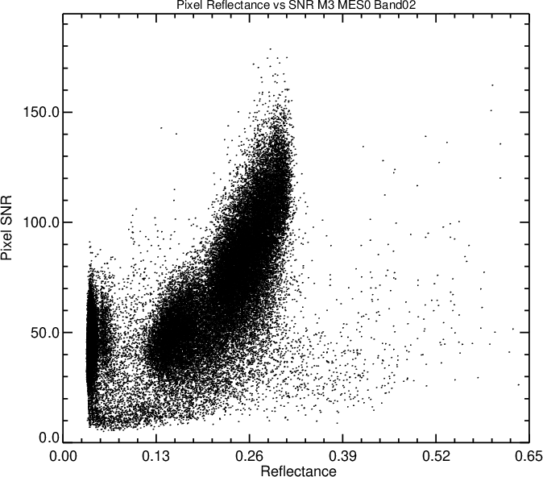
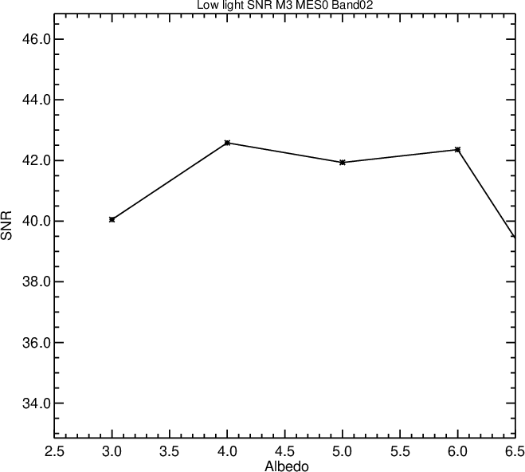
ABI-L1b-PLPT-009
Low Light SNR
Objective
Method
Use ABI L1b band 2 MESO L1b imagery.
For each of the 30 MESO scenes, compute a measure of spatial variability for each pixel.
For low-light pixels with low spatial variability – i.e., mainly clear-sky homogenous ocean regions - find the temporal difference between consecutive MESO scenes
Compile results from all MESO images and determine SNR statistics for 1% interval over the low-light for 3.5%-6.5% albedo range.
Characterize G17 band 2 SNR at low light 5% albedo level, validate the low light SNR for Band 2
Related Requirements for Provisional Maturity
MRD2156 - The GOES-R Space Segment shall produce Radiance product observations in low light (5% albedo) conditions in the 0.64 micron band at a 50:1 SNR
Results
Conclusion
Seeked the clear-sky homogenous region of stable G17 MESO L1b image at the day time.
Within the region selected with mainly clear-sky homogenous condition, the low-light SNR is calculated.
CWG characterized that the mean SNR at 5% albedo for G17 in the target is 45 at provisional review.
The mean SNR at 5% albedo for G17 in the target is 42 at full validation.
 | MRD | B02 SNR @5% Albedo
G17 Prov | 20 | 45
G17 Full | 20 | 42
Completed

Slide 31
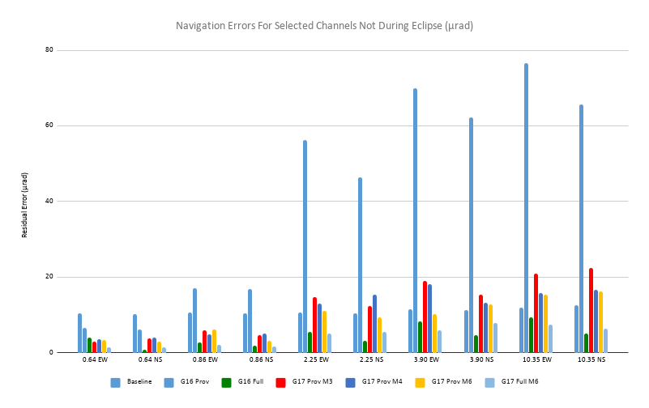

ABI-L1b-PLPT-010
Image Navigation
Methodology
Objective
Quantify the navigation residuals of ABI window channels. Check navigation stability. Trend performance during PLPT period and support other PLPTs as needed.
Related Requirements
MRD522 (Navigation errors not during eclipse); MRD523 (Navigation errors during eclipse); MRD538 and MRD539 (Frame-to-frame registration (FFR)).
Landmark use for the nav. error determination
Results
The CWG GOES-R ABI Image Navigation results can be found at the following links:
SLT Noon Navigation Residuals: https://www.star.nesdis.noaa.gov/GOESCal/G17_ABI_INR_daily.php
SLT Noon FFR:
https://www.star.nesdis.noaa.gov/GOESCal/G17_ABI_INR_daily.php
Daily Monitor Residuals:
https://www.star.nesdis.noaa.gov/GOESCal/G17_ABI_INR_daily.php
Daily Monitor FFR:
https://www.star.nesdis.noaa.gov/GOESCal/G17_ABI_INR_daily.php
Daily-Averaged Residuals for 2 Weeks:
https://www.star.nesdis.noaa.gov/GOESCal/G17_ABI_INR_daily.php
Daily-Averaged FFR for 2 Weeks:
https://www.star.nesdis.noaa.gov/GOESCal/G17_ABI_INR_daily.php
Summary
ABI in-frame navigation residuals meet requirements and the expected performance.
ABI frame-to-frame navigation residuals meet requirements and expected performance.
Navigation residuals during eclipse meet requirements and expected performance for eclipse.
Navigation residuals for Modes 6 only were evaluated. Evaluation drops some radiometrically-challenged images during the hot period.
COMPLETE

Slide 32
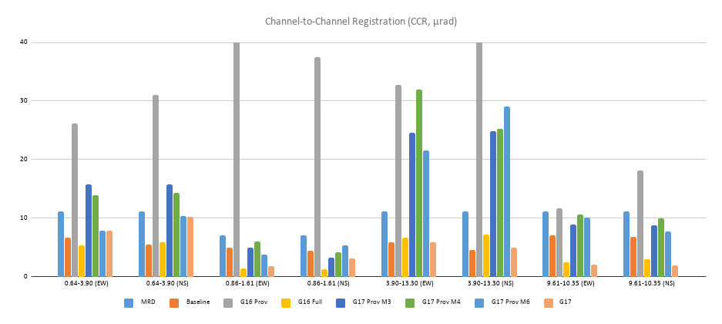
ABI-L1b-PLPT-011
Image Registration
Objective
Quantify the channel-to-channel registration (CCR) of the ABI window channels. Check CCR stability. Trend performance during PLPT period and support other PLPTs as needed.
Related Requirements
MRD529 – 533 (channel-to-channel registration). No expected performance baseline results for MRD531 and MRD533.
Methodology
Method 1: compare the navigation residuals of a channel pair.
Method 2: navigate one channel with respect to another.
Take most precise (lowest STD) result of two methods.
Results
The CWG GOES-R ABI Channel-to-Channel Registration results can be found at the following links:
SLT Noon CCR:
https://www.star.nesdis.noaa.gov/GOESCal/G17_ABI_INR_daily.php
Daily Monitor CCR:
https://www.star.nesdis.noaa.gov/GOESCal/G17_ABI_INR_daily.php
Daily-Averaged CCR for 2 Weeks:
https://www.star.nesdis.noaa.gov/GOESCal/G17_ABI_INR_daily.php
Summary
ABI in-FPA CCR residuals meet requirements and expected performance.
ABI inter-FPA CCR residuals meet requirements but exceed the expected performance. Possible way of improvement is a further refinement of co-registration algorithm.
COMPLETE

Slide 33
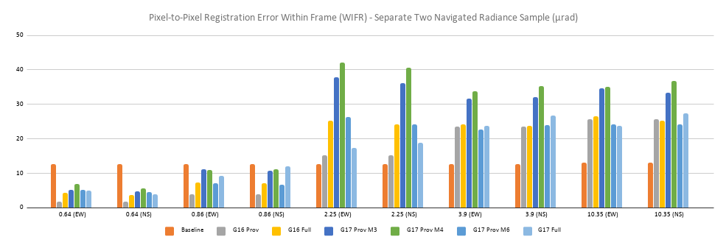
ABI-L1b-PLPT-012
Image Swath Registration
Objective
Assess the swath-to-swath registration (SSR) and within-frame registration (WIFR) errors of the ABI window channels. Trend performance during PLPT period and support other PLPTs as needed.
Related Requirements
MRD535 (pixel-to-pixel registration error within frame (WIFR-I) – separate two navigated radiance sample); MRD536 (pixel-to-pixel registration error within frame (WIFR-II) – register two adjacent lines/swaths)
Methodology
WIFR I error of an image is measured by the STD of landmark residuals. Ideal image has WIFR 1 equal to zero.
WIFR II error is the average absolute SSR measured at the swath boundary. It reflects tilt and stretch of ABI detector column.
Summary
ABI WIFR-I errors satisfy requirements most of the time. Elevated values are likely due to CENRAIS measurement algorithm and can turn out to be better with further refinement of CENRAIS algorithm.
ABI WIFR-II errors satisfy requirements and expected performance.
Results
The CWG GOES-R ABI Swath-to-Swath Registration and WIFR results can be found at the following links:
SLT Noon Swath Residuals:
https://www.star.nesdis.noaa.gov/GOESCal/G17_ABI_INR_daily.php
Daily Monitor STD (East-West and North-South):
https://www.star.nesdis.noaa.gov/GOESCal/G17_ABI_INR_daily.php
Daily-Averaged STD for 2 weeks (East-West and North-South):
https://www.star.nesdis.noaa.gov/GOESCal/G17_ABI_INR_daily.php
COMPLETE

Slide 34
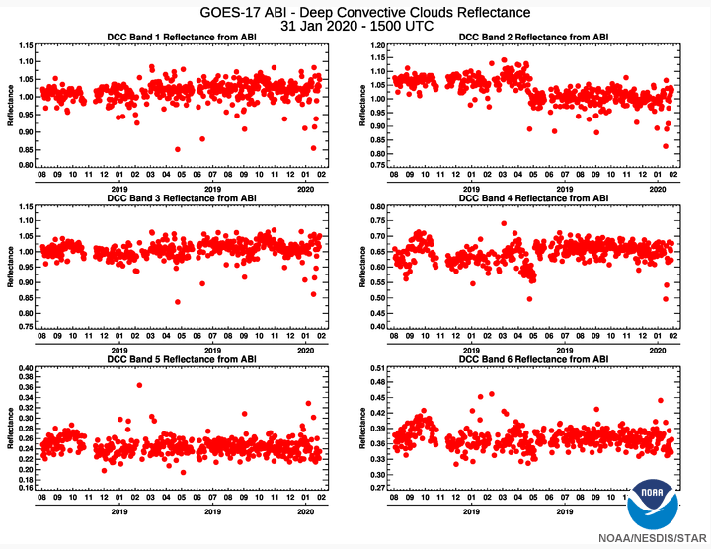
ABI-L1b-PLPT-013
VNIR Validation DCC
Methodology
The DCC pixels are described as followings:
20°S < latitude < 20°N and 167°W< longitude < 107°W
Brightness temperature at Band 14 (11µm) < 205 K
Standard deviation at Band 14 (11µm) < 1 K
Solar zenith angle < 40° and viewing zenith angle < 40 °
Reflectance standard deviation at Band 2 (0.64µm) < 0.03
Avoid sun glint area & data quality flag ≤ 1 for ABI data
Apply Spectral Band Adjustment Factor (SBAF) derived from SCIAMACHY and apply Angular Distribution Model (ADM) adjustment.
Objective
Validate the radiance accuracy of ABI’s six VNIR bands, using the VIIRS data and the GSICS algorithm.
Monitor ABI radiometric calibration stability using DCC reflectance.
Related Requirements
MRD737, MRD2120, MRD2130
Conclusion
DCCs reflectance from G17 ABI shows a stable and consistent pattern during long-term period.
The G17 ABI Band 2 positive bias correction is implemented into the ground system at 15:40 UTC on April 27, 2019 to reduce the radiance by 6.9% and a new algorithm for the Bands 4-6 is also applied to operational products to modify gain changes. We can clearly see the reduced positive bias in Band 2.
Compared with VIIRS/SNPP DCC results, G17ABI Bands 1-3 are slightly brighter (up to 4 %) than VIIRS bands and Bands 4-6 are comparable with VIIRS bands. DCCs are collected independently so the matched DCC results are provided separately.
Results
Time series of G17ABI DCC reflectance for VNIR bands
Completed

Slide 35
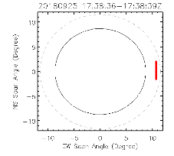
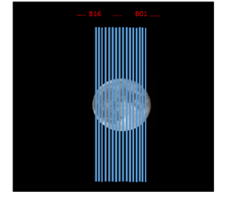

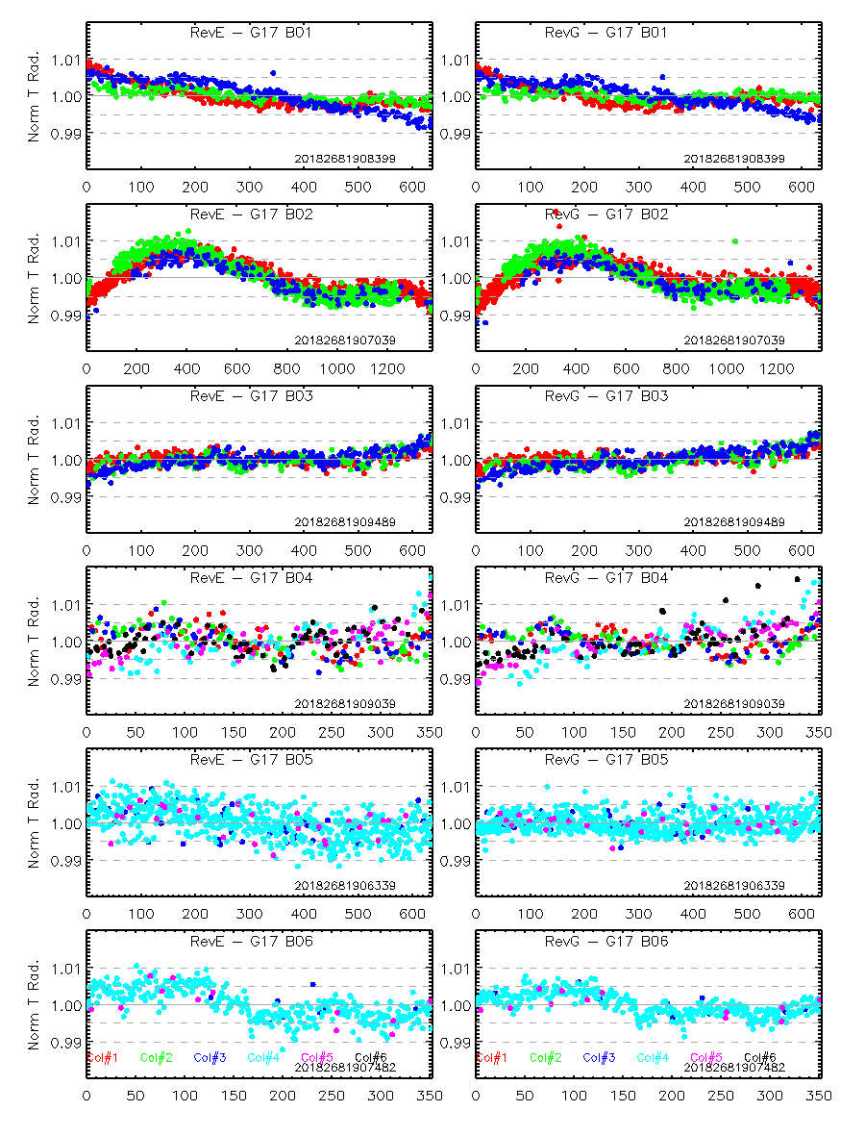
ABI-L1b-PLPT-017
Lunar NSS: VNIR Bands
Objective
Examine the detector response variation for each VNIR focal plane array using the north-south scan (NSS) of the illuminated Moon.
Related Requirements
MRD519: detector-to-detector radiance with relative accuracy in each band within 1-sigma noise
1-sigma for VNIR bands is ~0.3% albedo (SNR=300:1)
Method
ABI scans across the moon with north-south scan mode
Results
Conclusion
Detector-to-detector response in general varies gradually within the focal plane array
  few detectors may marginally meet the requirement
RevG algorithm improves the detector response uniformity at B04-B06
Variation patterns within the FPA can be observed at some VNIR bands
  May be larger than 1.% at B02
Comparable stanadard variation with G16, except for B04
  G17 B04 images may be noisier than G16 B04
Completed

Slide 36
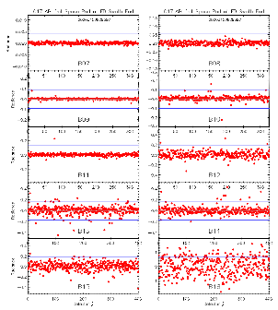
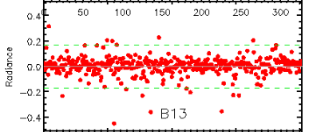
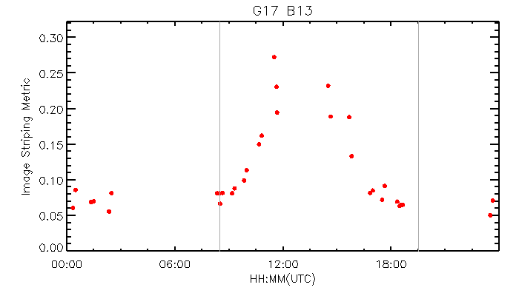
ABI-L1b-PLPT-018
IR Detector Uniformity
Objective
Verify detector-to-detector relative calibration variation
Related Requirements
MRD 519: The GOES-R space segment shall produce radiance product observations with relative accuracy in each band within 1-sigma of the noise of the same band for the following categories of relative error: Detector-to-Detector
Method
Subset calibrated space data at the ends of full-disk scans as the uniform reference
Image noise is
Det-to-det response variation is characterized with the normalized det-to-det radiance variation
Image striping is described with the standard deviation of the normalized radiance
Results
Conclusion
Image radiance noise increases with the focal plane module (FPM) temperature and jumps at the gain-set switch time
Some “out-of-family” detectors beyond the requirement can be observed at some IR bands in the gainset I period and the number of these detector may increase in the gainset III time at some IR bands
FPM temperature dependent detector-to-detector response variation can be observed at B11-B16.
  Need further study
Image diurnal striping performance: B13
Example of detector-to-detector variation in the gain-set I period: B13
Completed

Slide 37
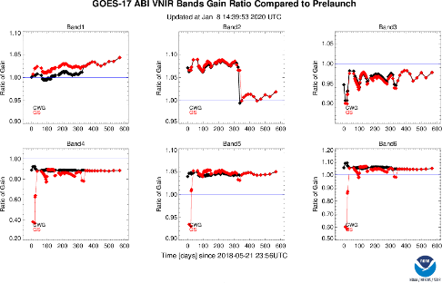
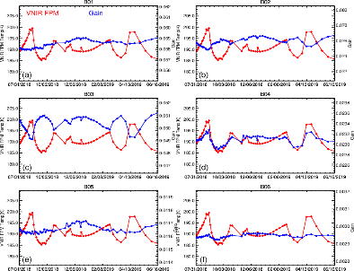
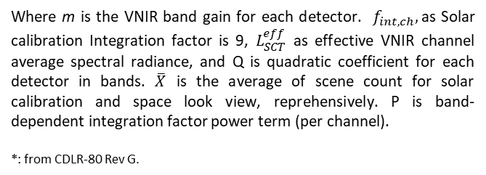

ABI-L1b-PLPT-019
VNIR Bands Initial Solar Calibration
Objective
Method
Establish the baseline of calibration based on Solar Calibration Target (SCT, also known as Solar Diffuser SD) for ABI visible and near infrared (VNIR) bands.
Related Requirements for Provisional Maturity
Derived calibration coefficients for ABI VNIR bands at the beginning of life (BOL).
Estimate the uncertainty of the derivation.
Compare with similar measurements and derivation pre-launch.
Reconcile discrepancies and provide the supports
Equation* to calculate VNIR band detector gain
$$m=\frac{f_{int,ch}∙L_{SCT}^{eff}}{\left({\overline{x}}_{SCT}−{\overline{x}}_{Solar_Cal_Space}\right)}−Q\frac{\left({\overline{x}}_{SCT}−{\overline{x}}_{Solar_Cal_Space}\right) }{{\left(f_{int,ch}\right)}^{p−1}}$$
Where m is the VNIR band gain for each detector. $f_{int,ch},$as Solar calibration Integration factor is 9, $L_{SCT}^{eff}$ as effective VNIR channel average spectral radiance, and Q is quadratic coefficient for each detector in bands. $\overline{X}$ is the average of scene count for solar calibration and space look view, reprehensively. P is band-dependent integration factor power term (per channel).
*: from CDLR-80 Rev G.
Results
Conclusion
G17 ABI VNIR Bands Solar Calibration trending:
https://www.star.nesdis.noaa.gov/GOESCal/G17_ABI_Solar_Cal_CWG_static.php
CWG characterized G17 ABI VNIR bands in mission-life, including before and after the initial three solar cal events on Jul 31,2018.
The first three solar cal gain pattern and magnitude generally agree each other with difference <0.5%.
CWG/GS detector gains agree very well since 05.05.2019 with the new lunar intrusion rejection LUT updated in GS.
B02 6.9% bias was mitigated in April,2019
B03-B06 striping and bias were resolved in May 2019.
Esun values version resolved in GS/CWG.
Impact of VNIR FPM temperature fluctuation on VNIR bands calibration was characterized and quantified.
Resolved the ADRs: 1036, 940, 917, 909, 878 ,839, 825, 815, 792, 752, 753, 754 and working on 814.
GOES-17 ABI VNIR bands mean gains from GS and CWG
Impact of G17 VNIR FPM temperature fluctuation on VNIR bands calibration
Completed

Slide 38
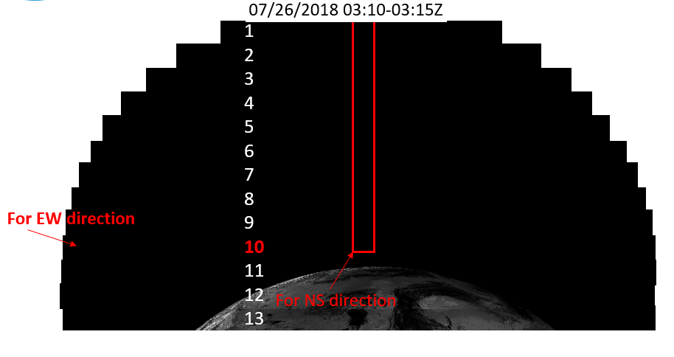
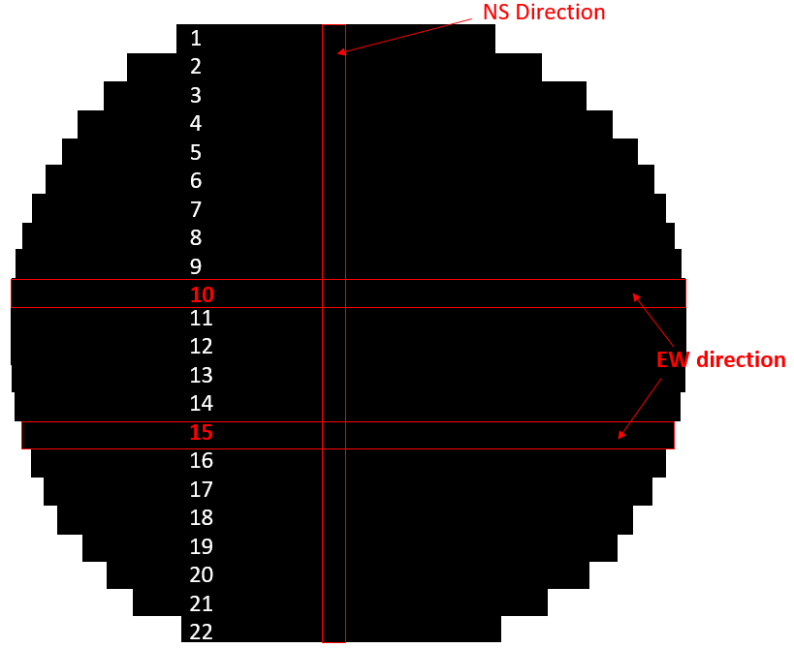
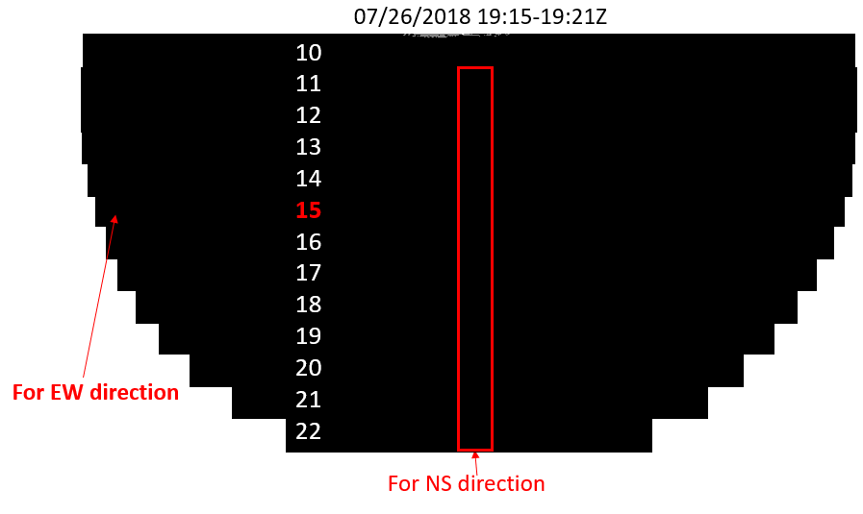


ABI-L1b-PLPT-020
Spatial Uniformity: IR Bands
Objective
To verify the spatial uniformity for the ABI IR bands
Related Requirements
MRD 737, 1493, 1503, 1513
Method
Space scan data collected during the roll-maneuver
+
Results
Conclusion
Full-disk swaths of space scans were collected via the roll maneuver right before the PLT/PLPT started.
Spatial uniformity period meets the waived requirements at both EW and NS directions during the gain-set I period
Completed
Calibrated space radiance for a FD swath in the roll-maneuver position

Slide 39


ABI-L1b-PLPT-024
Cal-To-Cal Repeatability
Objective
Assess the calibration-to-calibration repeatability for ABI.
Related Requirements
MRD519 (relative accuracy of radiance product).
ABIPORD235
Methodology
The IR calibration stability is evaluated by computing the RMS of consecutive CONUS image mean differences.
The assessment is made for the cool period only.
Results
Summary
The cal-to-cal repeatability is within the MRD requirements in terms of band average.
The repeatability has been improved since the provisional review for several IR bands, mostly due to the changes made to the scanning modes.
RMS in mK
Band | MRD Spec. | Prov. | Full
7 | 200 | 32 | 34
8 | 200 | 11 | 7
9 | 200 | 7 | 7
10 | 200 | 29 | 7
11 | 200 | 19 | 14
12 | 200 | 86 | 9
13 | 200 | 17 | 18
14 | 200 | 18 | 19
15 | 200 | 34 | 23
16 | 200 | 60 | 31
Completed

Slide 40

ABI-L1b-PLPT-025
Linearity
Objective
Validate the system linearity for selected channels of ABI.
Related Requirements
MRD Table 3.4.8.1.2 (ABI performance summary).
Methodology
Reanalyze the PLT ECAL data: nonlinearity is assessed by the maximum deviation from linear fitting between detector response of SCT/ICT and integration time.
colors: detectors
Results
Summary
The system requirement of linearity is met for most detectors and bands.
The results overall agree with vendor’s evaluation.
Later detector BDS update should improve the linearity of some outlier detectors.
There are still detectors with significantly large out-of-family non-linearity.
Non-linearity in percentage
Band | MRD Spec. | Band Max | Band Mean
7 | 1.00 | 0.088 | 0.057
8 | 1.00 | 18.2 | 0.116
9 | 1.00 | 0.377 | 0.049
10 | 1.00 | 0.433 | 0.075
11 | 1.00 | 31.7 | 0.237
12 | 1.00 | 0.529 | 0.234
13 | 1.00 | 32.7 | 0.526
14 | 1.00 | 16.1 | 0.119
15 | 1.00 | 0.184 | 0.108
16 | 1.00 | 0.741 | 0.364
Completed

Slide 41



ABI-L1b-PLPT-032
VNIR SNR and Dynamic Range
Objective
Method
Determine the ABI visible and near infrared (VNIR) channels’ signal-to-noise ratio (SNR) and Dynamic Range at the beginning-of-life (BOL).
Related Requirements
MRD737 (Long-term radiance drift);
MRD1493/MRD1503 MRD1513(Product Measurement Accuracy);
MRD2120(solar reflective channels to within an absolute accuracy of 5%)
Equations to calculate SNR and DNR
(1)
$$DNR=\left(2^{bits}− \overline{dnspc}\right)∗M$$
(2)
Where SNR is the VNIR band signal-noise-ratio, dn is the dynamic range for the detector dn is digital count; subscript SCT and SPC denote Solar Calibration Target (a solar diffuser) and space, respectively; the overhead bar denotes average; σ² is variance; DNR is the dynamic range for the detector, M the band gain.
Results
Conclusion
G17 SNR monitoring and trending:
https://www.star.nesdis.noaa.gov/GOESCal/G17_ABI_Solar_Cal_static.php
CWG characterized the features of GOES-17 ABI VNIR bands SNR in the overall mean and detector level.
VNIR bands mean SNR exceeded the specification recently. Bands 1-3 show stable while bands 4-6 show an improvement from the early stage.
Band-dependent at worst condition, especially bands 4-6.
G17 VNIR bands dynamic ranges all meet the requirements
GOES-17 ABI VNIR SNR mean, stdv, max, min from GS
GOES-17 ABI VNIR dynamic range, compared to the requirements.
Completed

Slide 42


ABI-L1b-PLPT-033
IR Calibration Stability
Objective
Evaluate the radiometric calibration stability for ABI IR channels.
Related Requirements
MRD519 (relative accuracy of radiance product).
Methodology
The IR calibration stability is evaluated by computing the standard deviation of the calibrated gain coefficient for a whole day (cool period only) and then convert it into the radiance variation:
The radiance variation is then converted to the brightness temperature variation:
where dLdT is the derivative of Planck’s function.
$$\frac{∆L}{L}=\frac{∆m}{m}$$
$$∆T=\frac{∆L}{dLdT}$$
Results
Summary
The calibration stability of IR bands is within the MRD requirements in terms of band average.
The calibration stability has been improved since the provisional review for several IR bands, mostly due to the changes made to the scanning modes.
The instability of the worse in-band detectors remains higher than the Specs.
RMS in mK
Band | MRD Spec. | Max* (Prov.) | Mean (Prov.) | Max (Full) | Mean (Full)
7 | 200 | 14 | 10 | 13 | 10
8 | 200 | 57 | 10 | 42 | 6
9 | 200 | 60 | 6 | 107 | 9
10 | 200 | 189 | 23 | 222 | 11
11 | 200 | 145 | 8 | 482 | 7
12 | 200 | 312 | 69 | 310 | 19
13 | 200 | 122 | 17 | 110 | 17
14 | 200 | 77 | 12 | 101 | 13
15 | 200 | 112 | 22 | 128 | 22
16 | 200 | 1285 | 126 | 563 | 115
Completed

Slide 43


ABI-L1b-PLPT-035
Coherent Noise
Objective
Evaluate the coherent noise for ABI.
Related Requirements
ABIPORD238
Methodology
Perform Fourier transform for cropped night time L1b images. Compare the Fourier series coefficients with the Spec. to check exceedance and on-orbit change.
FFT
Cropped Band 4 Night Time Image and Its Fourier Spectrum
Results
Summary
For VNIR bands 1-6, the coherent noise level is well within the system specification of requirement and is negligibly small for most of the bands.,
The level of the noise, if exists, has been stable. There is no noticeable temporal variation.
The coherent noise detected for band 2 is due to the calibration difference between the odd and even columns.
*: units - W/m²/sr/μm
Band No. | FFT Max* (2018) | FFT Max (2020) | FFT Max. in SI (2018) | FFT Max. in SI (2020)
1 | 0.0054 | 0.0006 | 0.0067 | 0.0007
2 | 0.1621 | 0.1513 | 1.0218 | 0.9542
3 | 0.0161 | 0.0110 | 0.0427 | 0.0292
4 | 0.0035 | 0.0044 | 0.0506 | 0.0627
5 | 0.0068 | 0.0092 | 0.0715 | 0.0967
6 | 0.0003 | 0.0003 | 0.0118 | 0.0110
Completed
Coherent Noise Characterization Results

Slide 44


ABI-L1b-PLPT-036
IR NEdT & Dynamic Range
Objective
Determine the SNR (NEdT) and dynamic range of ABI IR channels at the beginning-of-life (BOL)
Related Requirements
MRD 506 (radiometric sensitivity and dynamic range).
Methodology
Independently validate the NEdT calculation of GS and evaluate IR SNR using NEdT saved in INST-CAL.
Calculate the saturation radiance/temperature by
$$L_{max}=M\left(2^{14}−1−x_{spacelook,max}\right)$$
$$T_{max}=planck\left(L_{max}\right)$$
Typical daily trending of NEdT and saturation temperature
Results
Summary
The NEdT of IR detectors overall meet the system requirements during the cool period except for bands 12 & 16; the NEdT performance during warm period is much worse.
Some detectors exhibit out-of-family NEdT greater than the system requirements.
The dynamic range of IR detectors meet the system requirements during the cool period except band 13.
NEdT in mK
Band | MRD Spec. | Max* (Prov.) | Mean (Prov.) | Max (Full) | Mean (Full)
7 | 100 | 97 | 86 | 102 | 86
8 | 100 | 64 | 22 | 58 | 22
9 | 100 | 88 | 22 | 270 | 22
10 | 100 | 150 | 42 | 295 | 43
11 | 100 | 97 | 22 | 78 | 22
12 | 100 | 369 | 111 | 400 | 111
13 | 100 | 87 | 36 | 89 | 39
14 | 100 | 62 | 30 | 69 | 33
15 | 100 | 144 | 94 | 149 | 109
16 | 300 | 778 | 351 | 788 | 402
Completed

Slide 45


ABI-L1b-PLPT-037
Stray Light in SCT Look
Objective
Characterize possible stray light contamination of Solar Calibration Target (SCT) looks during solar calibration.
Related Requirements
MRD 2120
Methodology
solar calibration events beyond the nominal solar cal time.
Event (HH:MM UTC) | Solar Cal Cover (SCC)
06:05 | Open SCC
09:05 | Open SCC
12:05 | Closed SCC
12:06 | Open SCC, nominal Solar Cal.
15:05 | Open SCC
18:05 | Open SCC
Conclusion
A series of solar calibration events were conducted on 08/28/2018.
Straylight from the main optical port and the open SCC can not be detected for the events conducted on 12:05Z, 15:05Z and 18:05Z.
  ~0.16% at B06 with closed SCC at 12:05Z
Elevated SCT offset count can be observed at 09:05Z with SCC open (~4-5% of nominal solar cal data). No concern with it as SCC is normally in nearly “closed” position.
TIM meeting was held on 10/02/2018. Consensus was reached that there should be no concern for the straylight and SCC “NOTCLOSED” impacts.
Results
Delta Count (SCT-SPL) on 09:05Z
Delta Count (SCT-SPL) on 12:05Z
Completed

Slide 46

ABI-L1b-PLPT-038
Lunar Calibration
Objective
To verify and monitor the trending of solar reflective calibration, especially for B01-B03
Related Requirements
MRD 2120 and 2122
Methodology
Collect the lunar images with absolute phase angle within 5 and ~60 degrees from about four lunar trending events every month.
Use the lunar irradiance ratio between the ABI measurement and the model simulation to monitor the trending of solar radiance
  Straylight correction may be needed for the shorter wavelength channels
Conclusion
Collaborate with OPSO to ensure successful lunar image collections via PRO coordination every month.
  Verify the lunar trending schedule before trending event and image collection afterwards
  Only one G17 lunar trending event was partially corrupted (05/17/2019) due to the intermingled two lunar trending events. The moon in the last two B04 images was clipped.
Process the lunar data with the in-house scientific package
  No GS processed lunar images since April 2019
No significant trending is observed wit the lunar calibration result
  B02 K-LUT update reduces the radiance by 7.9%, in agree well with the 6-8% reduced radiance from the ray-matching method
Results
Time-series of normalized lunar irradiance ratio for G17 B01-B03.
Ongoing

Slide 47
Activities and Achievements

Slide 48
Summary of CWG Contributions
Supported the Program Reviews:
  Operational Transition Readiness Review (OTRR, Nov 2018).
  Summit (June 2019).
  Peer Stakeholder-Product Validation Review (PS-PVR) for Full Validation Maturity (Feb 2020).
Verified Ground Segment (GS) Upgrades:
  DO.08/09 (Mode 6, pCal, .
  Incremental and minor (FPM temp, TDQF, LUTs) updates.
Established Calibration Event Log (CEL).
Performed 22 Post-Launch Product Tests (PLPT).
Assisted Anomaly Resolution:
  Submitted 52 ADRs (Algorithm Discrepancy Report).
  Supported 73 ADRs.
  Closed 51 ADRs.

Slide 49
Major Solar Calibration Updates
Major Solar Calibration Events | GOES-16 | GOES-17
G16 Operational Date | 12/18/2017 | -
G16 B01-B03 Q LUT update | 01/17/2018 | -
Solar Cal. Algorithm update (Rev. F) | 02/07/2018 | 07/30/2018
Optimal Solar. Cal. Timing | 12/12/2017* | 07/30/2018
Solar Cal. Algorithm update (Rev. F’) | 12/26/2018 | 10/18/2018
G17 B01-B02 Q LUT update | - | 11/26/2018
G17 Operational Date | - | 02/12/2019
Solar Cal. Algorithm update (Rev. G) | 04/23/2019 | 04/08/2019
B02 solar cal. K LUT update | 04/23/2019 | 04/27/2019
Lunar rejection threshold LUT updates | 06/24/2019 | 05/05/2019
*: The optimal solar calibration timing was first conducted on 12/12/2017, then followed by several sub-optimal timing tests before 05/03/2018.

Slide 50
Major IR Calibration Updates
Major Solar Calibration Events | GOES-16 | GOES-17
G16 Scan-mirror emissivity LUT Update | 10/19/2017
G16 B10/B12 Lunar rejection threshold LUT Update | 09/26/2017
G16 Operational Date | 12/18/2017
G16 ICT PRT LUT Update | 06/19/2018
G16 B14-B16 Q LUT Update | 8/08/2018
G16 Solar Avoidance Earth Mask Update | 08/30/2018
G17 Scan-Mirror Emissivity LUT Update |  | 08/10/2018
G17 Timeline Mode Update (5 min ICT Cal.) |  | 09/05/2018
G17 Operational Date |  | 02/12/2019
Timeline Mode Change from Mode 3 to Mode 6 | 04/02/2019 | 04/02/2019
B07 Re-sampling Kernel LUT update | 04/23/2019 | 04/18/2019
Predictive Calibration (pCal) Algorithm Implementation |  | 07/25/2019
* BDS updates and the Dead Row List application for the de-striping effort and other calibration events are documented in the ABI calibration event log (CEL): https://www.star.nesdis.noaa.gov/GOESCal/goes_SatelliteAnomalies.php

Slide 51

GOES ABI Calibration Event Log
Widely used and praised by users and calibration colleagues

Slide 52
Significant Anomaly Resolutions – Radiometric
No. | ADR | Satellite | Issue/Anomaly | Impact | Status
1 |  | G16 | Reversed implementation of solar diffuser K-factor look-up-table | Striping and banding imagery | Resolved in Feb 2017
2 |  | G16/G17 | Fine Esun values | CWG’s fine Esun values provides more accurate reflectance for the solar reflective bands, especially for B01. Implemented for G17. | Resolved in Aug 2018
3 |  | G16 | Sub-optimal solar calibration timing | Resulted in uncertainty in the solar calibration coefficients which may lead to inaccurate solar radiance | Resolved in Dec 2017
4 |  | G16 | Periodic infrared calibration anomaly (PICA) caused by pre-launch measured scan-mirror emissivity parameters | Non-uniformly calibrated radiance at the East-West and North-South directions; Periodic variation in the CONUS and MESO images; Sudden jumps of radiance around satellite noon and midnight time | Resolved in Oct 2017
5 |  | G16 | Inaccurate Internal Calibration Target (ICT) temperature | Inaccurate calibration radiance for all the IR bands | Resolved in Jun 2018
6 |  | G16/G17 | IR striping caused by latched-up space-look count | The outdated space-look count, which is caused by the insufficient threshold to reduce the lunar intrusion impact, results in erroneous gain values and consequently striping | Open, waiting for GS update
7 |  | G16 | Potential different detector non-linear performance at solar cal. and earth scan | The incorrect non-linear response can result in striping at some solar reflective bands. The VNIR op. algorithm to be updated. | Feb 2018
8 |  | G16 | IR image de-striping with Q updates | Removed the striping at B10/B12 with the Q LUTs provided by CWG

Slide 53
Significant Anomaly Resolutions – Radiometric
No. | ADR | Satellite | Issue/Anomaly | Impact | Status
10 |  | G16/G17 | Abnormally cold pixels around hot fires. Only at B07 (3.9µm) | The abnormally cold pixels around extremely hot objects were corrected. | 53
11 |  | G16 | Contaminated IR pixels with refracted light | In the eclipse season, the solar light can be refracted into some IR pixels around the satellite midnight time with an insufficient solar avoidance earth mask. | Resolved in August 2018
12 |  | G16/G17 | Mitigation of the abnormal bright B02(0.64µm) radiance | CWG generated the solar calibration LUT and successfully reduced the B02 radiance which is now comparable to the common reference. | April 2019
13 |  | G16 | De-striping with new lunar intrusion LUTs | The lunar rejection threshold of B16 was updated to reduce the potential striping caused by detector | May 2019
14 |  | G17 | IR best detector selection (BDS) map update | Greatly reduced the strong striping during the “cold” focal plane module (FPM) temperature time | Dec 2018
15 |  | G17 | Use of the dead row list (DRL) for striping reduction | Reduced strong striping at IR Bands 10/11/13/15 | Dec 2018
16 |  | G17 | In-sufficient ICT calibration frequency | More ICT calibration frequency within the normal operational timeline to reflect the quick changing detector response to the uncontrolled FPM temperature. Improve the IR calibration accuracy at the “warm” FPM period | Oct 2018

Slide 54
Significant Anomaly Resolutions – Radiometric
No. | ADR | Satellite | Issue/Anomaly | Impact | Status
17 |  | G17 | Periodic Infrared Calibration Anomaly | Some of G17 ABI IR bands experienced swath-to-swath, meso-to-meso, and CONUS-to-CONUS calibration variation. Worked together with MOST/MIT/LL to find the root cause due to the dark current variation after geometric calibration events. Significantly improved with the new G17 timeline. | Improved in Mar 2019
18 |  | G16/G17 | Discrepancy in the detector solar calibration gains | The op. detector solar gain values can be inaccurately calculated with the locked solar calibration spacelook count. | Temporally resolved in May 2019
19 |  | G16/G17 | De-striping with BDS update | Remove the strong striping caused by “bad” detectors which are either saturated or unstable. | Mission life
20 | 860 1013 | G17 | IR SRF at 81K | Improve the G17 IR radiometric calibration accuracy to comparable with G16 IR bands at time when FPM is at 81K. | Waiting for GS implementation
21 |  | G17 | Fluctuation of solar calibration coeff. with the VNIR FPM temperature | Caused by the floating FPM. Leads to diurnal and seasonal variations of radiometric calibration accuracy for more than 1% at some VNIR bands. | Waiting for GS implementation
22 |  | G17 | Strong streaks caused by the lunar intrusion at spacelook | Strong steaks appears in multiple bands. When the intrusion occurs in the spacelook used for ICT, the steaks occur in the images in the following 5 minutes. the new lunar intrusion algorithm will resolve the anomaly. | Waiting for GS implementation
23 |  | G16/G17 | Handing detector ICT saturation | The op. algorithm is insufficient in handling the saturated ICT counts, resulting in striping. | On-going

Slide 55
Significant Anomaly Resolutions – Geometric
No | Date | ADR | Event | Impact
1 | 2019 03-08 | TBS | Anomalous ABI navigation precision scaling with the scan mode. | Co-registration algorithm adjustment is likely needed.
2 | 2019 03-27 | - | Yaw flip evaluation | Usefulness of T19 is emphasized and recommended for a broader use
3 | 2019 0402 |  | Modes 3, 4, and 6 navigation comparison | Helped to design correct Mode 6 timeline tests
4 | 2019 04-19 | 944 | Incomplete ABI output in the Yaw Flip | Improved interaction between the parts of the GOES-R Program
5 | 2019 04-25 | 951 | Short-term navigation anomalies | Confirmed to be caused by the short-term (less than 2 sec) gyro data gaps. Fix scheduled for DO.09.
6 | 2019 05-01 | 922 | Qboost LUT Update verification | Verified FD image navigation after Qboost LUT update
7 | 2019 05-01 | 955 | East-West and North-South navigation anomaly | Gyro rate gap also confirmed as the reason, fix in DO.09
8 | 2019 06-04 | - | CWG requested to provide navigation input for ABI AI | CWG has implemented a precise evaluation line of processing
9 | 2019 06-06 | - | GOES-R Summer Summit participation | New method for detector map evaluation is presented

Slide 56
Significant Anomaly Resolutions – Geometric
No | Date | ADR | Event | Impact
10 | 2019 07-25 | TBS | Day of a “fuzzy navigation” after DO.08 deployment | Confirmed by IPATS and PM, the reason and impact on the products are still unknown
11 | 2019 09-09 |  | Yaw flip evaluation | Clean data output for users was in the focus of CWG
12 | 2019 09-10 |  | 2-month CWG monitoring data made available to the vendor to help in the SIMD anomaly diagnostics | The root cause of the SIMD anomaly is identified, vendor’s fix is successfully applied
13 | 2019 09-29 | 1011 | Spacecraft gyro rate cap for ABI adjustment (CWG suggestion made in 2017) | CWG evaluation shows a noticeably better (20%) navigation precision.
14 | 2019 10-01 |  | Star tracker anomaly investigation | Confirmed good image navigation with just one star tracker
15 | 2019 10-12 | 922 | Qboost LUTs corrupted during DO.08 installation | CWG confirms successful restoration of correct Qboost LUTs
16 | 2019 10-15 | - | Cooling test evaluation | Normal navigation and additional data availability is confirmed by CWG.
17 | 2019 10-30 | BP196 | CWG was invited to participate with PM navigation evaluation by Flight | CWG confirmed that PM provides elevated estimates for ABI navigation errors. CWG will provide regular evaluation of all navigation metrics.

Slide 57
Active Calibration ADR
ADR # | Description | PoC | Module | Status
292 | ABI INST-CAL Offset Field Irregularities | ZW | All | Active
304 | DO.04.04 ABI INST-CAL-ENG Data Show Irregularities | ZW | All | Active
594 | ABI Lunar Intrusion Level Latchup: Longer Term Fix | ZW | G-16 | Active
642 | Two ABI M2 files per channel for every SCT event | HQ | G-16 | Hold
704 | ABI CDRL42 Updates for GS PG L1b Processing | ZW | G-16 | Active
732 | G16 ABI Band3 Striping | HQ | G-16 | Hold
769 | same time coverage timing at G16/G17 lunar L1alpha | FY | G-17 | Active
800 | empty data field in INST-CAL | ZW | All | Active
803 | G-17 lunar intrusion rejection algorithm revision | ZW | G-17 | Hold
817 | fill-in spacelook statistics in INST-CAL | ZW | All | Active
831 | output gain setting info | ZW | G-17 | Active
853 | Missing GOES-17 ABI Lunar L1alpha data from LZSS | FY | G-17 | Active
856 | G16/17 Band 2 INST-CAL subset file missing | HQ | All | Active
860 | Dependency of G17 ABI SRF on FPM Temperature | FY | G-17 | Active
Red ADRs affect L1b data quality and are addressed in Remaining Issues.

Slide 58
Active Calibration ADR
ADR # | Description | PoC | Module | Status
867 | Scene Radiance Dependent Bias for G17 VNIR Bands | FY | G-17 | Active
881 | G16 INST-CAL-M2 and INST-CAL-EPH files missing | HQ | G-16 | Hold
888 | Dependence of G17 VNIR Gain on FPM Temperature | FY | G-17 | Active
911 | Erroneous G-17 ABI B13 INST-CAL data at high FPM | ZW | G-17 | Active
948 | Missing G16/G17 solar spacelook count statistics | HQ | All | Active
949 | Missing G17 INST-CAL files at LZSS and PDA | HQ | G-17 | Active
951 | ABI/G16 VNIR North-South Navigation Anomaly | VK | G-16 | Active
964 | Revise GPA’s handling detector SL saturation | ZW | All | Active
967 | loss of data quality info at high FPM temperature | ZW | G-17 | Active
986 | Sporadic missing data on the CONUS/FD L1B images | HQ | G-17 | Active
1013 | Update G17 (FM2) IR SRF at 81K | FY | G-17 | Active
1055 | Missing/Incomplete Vertical Lines at G16 L1A Data | FY | G-16 | Active
1058 | Meso2 Location Error | VK | G-17 | Submitted
Red ADRs affect L1b data quality and are addressed in Remaining Issues.

Slide 59
ABI ADR Submitted by other groups (2020-01-27)
ADR # | Description | PoC | Module | Status
777 | Controlling deployment of ABI SCT-derived gains | HQ | All | Active
832 | GOES-16 X-axis Bias Anomaly | VK | G-16 | Active
893 | ABI Predictive Calibration Algorithm | ZW | G-17 | Active
938 | ABI L1b Metadata Update for B02 Bias Fix | HQ | All | Active
962 | ABI DRL modification for testing G16 B16 Det211 | ZW | G-16 | Hold
1007 | Gain Set Switch/pCal deconfliction long-term fix | XW | G-17 | Active
Category | All | CWG
Calibration ADR | 206 | 137
Active Calibration ADR | 33 | 27
GOES-17 ABI Calibration ADR | 73 | 52
Active GOES-17 ABI Calibration ADR | 22 | 17
Statistics based on CWG records of GOES-R ADR saved at
https://docs.google.com/spreadsheets/d/12c6LZ_6ph5IeMFUjENIrETLQuzPpzHi2sBPPE4Or6w0/edit#gid=1591499741

Slide 60
Unstable FPM Temperature

Slide 61
Mitigations and Impacts
Mitigations:
  Diurnal Gain Set III: Low gain to reduce (avoid) saturation.
  Semi-Annual Yaw Flip: Reduce thermal load.
  Predictive Calibration: Reduce bias between calibration updates.
  Right strategy and priority leading to optimal results.
Impacts:
  Geometric:
    Negligible impacts, direct or indirect.
    For example, blurred imagelet to verify with “chips”.
  Spectral:
    Some impacts, channel dependent.
  Radiometric:
    Serious impacts in multiple ways.
    Major effects and efforts.

Slide 62
Evaluation of Mitigations
Noise
  Much elevated in general for IR.
    Negligible for VNIR.
  Diurnal and seasonal variation.
  Characterize and inform users (TDQF).
    Issue: TDQF may be improved with better understanding of saturation.
Accuracy
  Change too much between calibration update – Predictive Calibration
    Implementation
    Timing
    Near saturation
  Spectral Response Function
  VNIR calibration
  Space count contamination & latch-up
Stability (in time, space, spectral, etc.):
  Characterize and inform users.

Slide 63
Noise (NEdT/NEdN)

Slide 64










G17 ABI IR Channel NEdT
Jan Dec Nov Oct Sep Aug Jul Jun May Apr Mar Feb Jan Dec
Band 07 (3.9um)
Jan Dec Nov Oct Sep Aug Jul Jun May Apr Mar Feb Jan Dec
Band 08 (6.185um) Band 09 (6.95um)
Band 10 (7.34um)
Jan Dec Nov Oct Sep Aug Jul Jun May Apr Mar Feb Jan Dec
Jan Dec Nov Oct Sep Aug Jul Jun May Apr Mar Feb Jan Dec
00:00
06:00 12:00 18:00
Time (UTC)
Band 11 (8.5um)
00:00 00:00
06:00 12:00 18:00
Time (UTC)
Band 12 (9.61um)
00:00 00:00
06:00 12:00 18:00
Time (UTC)
Band 13 (10.35um)
00:00
00:00
06:00 12:00 18:00
Time (UTC)
Band 14 (11.2um)
00:00
Jan Dec Nov Oct Sep Aug Jul Jun May Apr Mar Feb Jan Dec
Jan Dec Nov Oct Sep Aug Jul Jun May Apr Mar Feb Jan Dec
Jan Dec Nov Oct Sep Aug Jul Jun May Apr Mar Feb Jan Dec
Jan Dec Nov Oct Sep Aug Jul Jun May Apr Mar Feb Jan Dec
00:00
06:00 12:00 18:00
Time (UTC)
Band 15 (12.3um)
00:00 00:00
06:00 12:00 18:00
Time (UTC)
Band 16 (13.3um)
00:00
00:00
06:00
12:00
Time (UTC)
18:00
00:00
00:00
06:00
12:00
Time (UTC)
18:00
00:00
Jan Dec Nov Oct Sep Aug Jul Jun May Apr Mar Feb Jan Dec
Jan Dec Nov Oct Sep Aug Jul Jun May Apr Mar Feb Jan Dec
G17_NEdT/G16_NEdT
1
5
NEdT < MRD: 67.54%
NEdT > MRD: 29.64%
ICT Saturated: 2.82%
“Not Useful” > 3% (TDQF)
00:00
06:00 12:00 18:00
Time (UTC)
00:00 00:00
06:00 12:00 18:00
Time (UTC)
00:00

Slide 65
Band 07 (3.90um)
Jan
Dec
2.458810
Nov
Oct
Sep _{Aug} 2.458710
Jul Jun
May 2.458610
Apr
Mar Feb
Jan
2.458510
Dec
00:00
03:00
06:00
09:00
12:00
Time (UTC)
15:00
18:00
21:00
00:00

Slide 66
Band 08 (6.19um)
Jan
Dec
2.458810
Nov
Oct
Sep _{Aug} 2.458710
Jul Jun
May 2.458610
Apr
Mar Feb
Jan
2.458510
Dec
00:00
03:00
06:00
09:00
12:00
Time (UTC)
15:00
18:00
21:00
00:00

Slide 67
Band 09 (6.95um)
Jan
Dec
2.458810
Nov
Oct
Sep _{Aug} 2.458710
Jul Jun
May 2.458610
Apr
Mar Feb
Jan
2.458510
Dec
00:00
03:00
06:00
09:00
12:00
Time (UTC)
15:00
18:00
21:00
00:00

Slide 68
Band 10 (7.34um)
Jan
Dec
2.458810
Nov
Oct
Sep _{Aug} 2.458710
Jul Jun
May 2.458610
Apr
Mar Feb
Jan
2.458510
Dec
00:00
03:00
06:00
09:00
12:00
Time (UTC)
15:00
18:00
21:00
00:00

Slide 69
Band 11 (8.50um)
Jan
Dec
2.458810
Nov
Oct
Sep _{Aug} 2.458710
Jul Jun
May 2.458610
Apr
Mar Feb
Jan
2.458510
Dec
00:00
03:00
06:00
09:00
12:00
Time (UTC)
15:00
18:00
21:00
00:00

Slide 70
Band 12 (9.61um)
Jan
Dec
2.458810
Nov
Oct
Sep _{Aug} 2.458710
Jul Jun
May 2.458610
Apr
Mar Feb
Jan
2.458510
Dec
00:00
03:00
06:00
09:00
12:00
Time (UTC)
15:00
18:00
21:00
00:00

Slide 71
Band 13 (10.3um)
Jan
Dec
2.458810
Nov
Oct
Sep _{Aug} 2.458710
Jul Jun
May 2.458610
Apr
Mar Feb
Jan
2.458510
Dec
00:00
03:00
06:00
09:00
12:00
Time (UTC)
15:00
18:00
21:00
00:00

Slide 72
Band 14 (11.2um)
Jan
Dec
2.458810
Nov
Oct
Sep _{Aug} 2.458710
Jul Jun
May 2.458610
Apr
Mar Feb
Jan
2.458510
Dec
00:00
03:00
06:00
09:00
12:00
Time (UTC)
15:00
18:00
21:00
00:00

Slide 73
Band 15 (12.3um)
Jan
Dec
2.458810
Nov
Oct
Sep _{Aug} 2.458710
Jul Jun
May 2.458610
Apr
Mar Feb
Jan
2.458510
Dec
00:00
03:00
06:00
09:00
12:00
Time (UTC)
15:00
18:00
21:00
00:00

Slide 74
Band 16 (13.3um)
Jan
Dec
2.458810
Nov
Oct
Sep _{Aug} 2.458710
Jul Jun
May 2.458610
Apr
Mar Feb
Jan
2.458510
Dec
00:00
03:00
06:00
09:00
12:00
Time (UTC)
15:00
18:00
21:00
00:00

Slide 75
Summary
Elevated noise is a direct consequence of the LHP anomaly.
Limited trade-off options:
  Gain set has been nearly optimized (except perhaps B14).
  “Cooling” timeline to “give it a break”.
Characterize for decision-making.
  Quantification and monitoring: Established and continue.
  Temperature Date Quality Flag (TDQF):
    Empirical, by image inspection initially and comparison with GOES-16 later.
    Analytical LUT: Design, implementation, performance, and improvement of the algorithm for saturation.

Slide 76


IR performance chart
Apr. 10, 2019 at 10:20 UTC Band 12
OR_ABI-L1b-RadF-M6C12_G17_s20191001020341_e20191001029413_c20191001029459.nc
Radiance is calculated
with all reasonable values.
DQF = 0
(good data)
DQF = 4
(FPM T > threshold)
Notes:
Please also plot for Channel 9-16 with y-range appropriate for gain set I, e. g., [-0.2,0.2] for the right panel (probably also for the left).

Slide 77


IR performance chart
Apr. 26, 2019 at 12:20 UTC Band 12
OR_ABI-L1b-RadF-M6C12_G17_s20191161220341_e20191161229413_c20191161229453.nc
Radiance has mostly zero
or 1 less than fill_value.
DQF = 4
(FPM T > threshold)
Notes:
Please also plot for Channel 9-16 with y-range appropriate for gain set I, e. g., [-0.2,0.2] for the right panel (probably also for the left).

Slide 78
Initial FPM Temperature Thresholds for DQF Flags
Band # | WL (um) | Warming Side (Increasing) | Cooling Side (Decreasing)
 |  | K | K
7 | 3.9 | 150 | 150
8 | 6.2 | 93 | 94
9 | 7.0 | 94 | 94.5
10 | 7.3 | 91 | 92
11 | 8.4 | 97 | 98
12 | 9.6 | 89 | 90
13 | 10.3 | 104 | 105
14 | 11.2 | 104 | 105
15 | 12.3 | 93.5 | 94.5
16 | 13.3 | 89.5 | 91
Operational starting August 8, 2019
These are the currently operational values, based on full disk data (remapped) from April 13-14, 2019 where GOES-17 is from predictive calibration sample data. These values assume the MWIR FPM is 0.2 K cooler than the LW.
Notes:
G17-G16 Diff > 1K or > 2K determined by a baseline G17-G16 difference defined as the mean G17-G16 difference between 00:00 UTC and 08:00 UTC that day. So 1K means 1K different (greater than or less than) from that baseline.
G17 Unusable determined by a G17-G16 Difference > 5K from Baseline. For images on this day this was a good estimate of when a user would determine that imagery had either become completely useless, “saturated”, or blank by looking at it.

Slide 79
Empirical Modification of Temperature Thresholds
Band # | WL (um) | Warming Side (Increasing) | Cooling Side (Decreasing)
 |  | K | K
7 | 3.9 | 150 | 150
8 | 6.2 | 93 | 94
9 | 7.0 | 93.5 | 94.0
10 | 7.3 | 91 | 92
11 | 8.4 | 97 | 98
12 | 9.6 | 89 | 90
13 | 10.3 | 104 | 105
14 | 11.2 | 104 | 105
15 | 12.3 | 93.0 | 94.0
16 | 13.3 | 87 | 88
Notes:
G17-G16 Diff > 1K or > 2K determined by a baseline G17-G16 difference defined as the mean G17-G16 difference between 00:00 UTC and 08:00 UTC that day. So 1K means 1K different (greater than or less than) from that baseline.
G17 Unusable determined by a G17-G16 Difference > 5K from Baseline. For images on this day this was a good estimate of when a user would determine that imagery had either become completely useless, “saturated”, or blank by looking at it.

Slide 80
Empirical Modification of Temperature Thresholds
Band # | WL (um) | Warming Side (Increasing) | Cooling Side (Decreasing)
 |  | K | K
7 | 3.9 | 150 | 150
8 | 6.2 | 93 | 94
9 | 7.0 | 93.0 | 94.0
10 | 7.3 | 90.5 | 91.5
11 | 8.4 | 97 | 98
12 | 9.6 | 89 | 90
13 | 10.3 | 100 | 101
14 | 11.2 | 93.0 | 94.0
15 | 12.3 | 92.0 | 93.0
16 | 13.3 | 86 | 87
These are the new proposed values, based on full disk data GOES-16/17 comparisons when GOES-17 has both predictive calibration and the modified DQF. MWIR values based on MWIR FPM Temps from INST-CAL files.
Notes:
G17-G16 Diff > 1K or > 2K determined by a baseline G17-G16 difference defined as the mean G17-G16 difference between 00:00 UTC and 08:00 UTC that day. So 1K means 1K different (greater than or less than) from that baseline.
G17 Unusable determined by a G17-G16 Difference > 5K from Baseline. For images on this day this was a good estimate of when a user would determine that imagery had either become completely useless, “saturated”, or blank by looking at it.

Slide 81
Predictive Calibration (pCal)

Slide 82


Problem: Unstable Instrument
Calibration uses the last measurement until it’s updated.
IR sensors need frequent calibration update.
  Before any measurement has changed too much.
G17 measurements can change too much between update.
  Cannot be calibrated more frequently.
~300 counts in ~600 min., or 0.25 count between update.
~8000 counts in ~300 min. or 13 counts between update.

Slide 83
Solution: Predictive Calibration
Instead of using the last measurement until the new one is available, extrapolate the last two to a future time, i.e., predictive.
Other relevant information:
  Wish to interpolate, but can’t wait.
  Tried but abandoned nonlinear predictions.
    Likely because of measurement noise.
  Effective near saturation.

Slide 84
Execution
Simple concept. Complicated implementation.
Designed and implemented by ABI vendor.
  Results released Jan 2019.
  Algorithm briefed to CWG Feb 27, 2019.
  Verification and feedback.
Implemented in GS summer 2019.
  Infrequent Update.
  Spurious Triggered oCal.
  Near Saturation.
  Activation / Deactivation to Avoid Collision.
Good results in the end.

Slide 85








Infrequent Update of Space Count
GS Offline
GS pCal behaves differently from offline implementation
pCal
K
“salt and pepper” due to nav differences between GS and offline without GS Kalman history
Baseline
K
pCal not yet engaged in GS
diffs
pCal engaged but
behaving unexpectedly
PWG 7/1/19

Slide 86
Spuriously Triggered pCal
Turns back on
Turns off
Extend the averaging window to ensure monotonic temperature change.
Turns on
Turns back off

Slide 87

Spuriously Triggered pCal

Slide 88


Near Saturation
G17 Band 8 FD swath
predictive
improved predictive
Radiance
13-Aug-2018 09:11:59 UTC
Reduced nonlinearity.
Extend the useful data until earth scene is saturated.

Slide 89

Collision of pCal with Gain Set Switch
pCal cannot be active during Gain Set Switch (GSS).
  Would lead to incorrectly extrapolated gain.
Short-term solution:
  Activate / deactivate according to FPM temperature (the only available control).
  Labor intensive and error prone.
Mid-term solution:
  Controlled by clock for fixed GSS times.
Long-term solution:
  Controlled by GSS for dynamic GSS

Slide 90

Pcal – Short Term
?
√
Aug. 9 – Case 9

Slide 91





G-17 LWIR FPM Temperature
81.5
Temp (K)
1900 Temp
81.0
0900 Temp
We are here
Min Temp
80.5
20190227
20190508

Slide 92


Slide 93


Slide 94
Performance 7/4-8/11

Slide 95




Improvement of pCal via GEO-LEO
2018/Oct
2019/Oct, pCal
Improvement depends on time of day, day of year, and channel.

Slide 96




Improvement of pCal via GEO-LEO
2018/Oct
2019/Oct, pCal
Improvement depends on time of day, day of year, and channel.

Slide 97

Improvement of pCal via GEO-GEO
Improvement depends on time of day, day of year, and channel.

Slide 98



Improvement of pCal via GEO-GEO
Before the satellite drift, 2018
After the satellite drift, 2019
Saturated radiance
pCal reduces the error when not saturated.
pCal
Improvement depends on time of day, day of year, and channel.

Slide 99




Improvement of pCal via GEO-GEO
Before the satellite drift, 2018
After the satellite drift, 2019
pCal reduces the error when not saturated.
Improvement depends on time of day, day of year, and channel.

Slide 100
Other Consequences of Unstable FPM Temperature – VNIR Gain

Slide 101

VNIR Channels Calibration
04.23
Reprocessed G17 solar calibration with CWG in-house package with CDRL-80 Rev G and CDLR-79 Rev N.
Ratio of mean VNIR bands gains of CWG to the prelaunch for G17 solar calibration
Up to ~4% of mean gain variation in B03 (ADR815/888), a similar moderate pattern also found in B02.

Slide 102

VNIR FPM Temperature And Gain Also Fluctuate
Table Slopes, uncertainty and correlation from the linear regression of GOES-17 ABI VNIR band gain change and VNIR FPM temperature change between the two consecutive solar calibration events from 07/31/2018 to 06/16/2019.
Bands | B01 | B02 | B03 | B04 | B05 | B06
Slope | -0.012 | -0.104 | -0.274 | 0.099 | -0.006 | 0.055
Uncertainty | 0.00983 | 0.01062 | 0.00943 | 0.00816 | 0.00819 | 0.00981
Correlation | -0.15 | -0.79 | -0.97 | 0.85 | -0.1 | 0.59
Left : G17 VNIR FPM temperature vs B02/03/04 mean gain and the scatter plotting of rate of gain change vs FPM change between the two consecutive solar calibration events
Top : Slopes, uncertainty and correlation from the linear regression of GOES-17 ABI VNIR band gain change and VNIR FPM temperature change between the two consecutive solar calibration events from 07/31/2018 to 06/16/2019.
Anti-correlation in B03/02 and positive correlation in B04.
Generally, VNIR FPM temperature change caused about ~0.27%/1k of gain change in B03 and 0.1% /1k in B02/B04
Mitigation:
Disable automated update
Enable Bring-Your-Own-Gain.
Figure (a) GOES-17 ABI VNIR B02 mean gain in blue from CWG in-house reprocessing and VNIR FPM temperature in red. (b) Scatter plotting for B02 mean gain rate vs VNIR FPM temperature rate between the two consecutive solar calibration events with the linear regression fitting. The similar pair plotting for B03 in (c)(d) and for B04 in (e)(f).

Slide 103
Other Consequences of Unstable FPM Temperature – SRF

Slide 104

ITE Test Results
Spectral Response Function (SRF) was measured for 60K prelaunch.
GOES-17 ABI operates at 81K when stable.
The ITE output radiance/gain agree very well with the previous simulation results

Slide 105
Updated SRF@81K Improved Accuracy
Big change in B16
Improvement in GEO-LEO: B8, B14, B15 and B16
Improvement in G17 vs. G16: B9, B11, and B16
Reduced inter-calibration at GEO-LEO & GEO-GEO Inter-Calibration: B12.
G17-G16: -0.02 (60K) vs. -0.11 (81K).
GEO-LEO: -0.12 (60K) vs. -0.21K (81K)
Changes in the other channels are small (<0.1K)

Slide 106
Other Consequences of Unstable FPM Temperature – Latch-Up

Slide 107
Background
Moon can enter ABI’s FOV (“lunar intrusion”) to compromise its space view for calibration.
  Space view to determine the delta-count for ICT view, SCT views, and earth view.
GPA can detect and reject (find the replacement) lunar intrusion, based on the expected count change due to instrument fluctuation and lunar intrusion.
GOES-17 ABI behavior is unexpected.
  Disable the lunar intrusion rejection for ICT & earth view, which caused occasional anomalies.
  Did not disable for SCT views, which caused anomaly until April 2019.
  Improved algorithm has been waiting for implementation.

Slide 108





Space Counts for Earth View
Investigated the root cause to the streak in G17 B02 image (WR7199) at 05:10Z on 06/27/2019
  Root cause was the lunar intrusion in the spacelook. The streak can be observed at the FD/CONUS/MESO images for B02/B07/B16 collected at 05:12Z.
  An ABI CEL as the anomaly online report.
Band 2
Band 7
Band 16
CONUS
MESO

Slide 109

Space Counts for Earth View
Space-look contaminated at these two swaths
Image by RAMMB/CIRA
Compromise one (or two) swath for one or a few channels.
Wait for the implementation of new algorithm.

Slide 110

Space Counts for ICT View
Lunar contamination of space look for ICT calibration on 9/15.
CWG will predict this for
  SCT calibration: Change the date;
  ICT calibration: Notify PRO, and then … OSPO to withhold the data?

Slide 111

Space Counts for ICT View
Compromise all swaths for five minutes, for one or a few channels.
Predict, warn, and wait for the implementation of new algorithm.

Slide 112

Space Counts for SCT View
Lunar intrusion rejection was not disabled, causing latch-up until April 2019.
Predict, avoid, and wait for the implementation of new algorithm.

Slide 113
Remaining Issues

Slide 114
Three Categories
Category I – Non-Compliance (2)
  Rejection of Lunar Intrusion
  Gyro Rate Drop
Category II – User Beware (6)
  SRF @ 81K
  VNIR Gain Dependence on FPM Temperature.
  Saturation Algorithm
  Bias Change After Yaw Flip, Star Look, and Gain Set Change.
    No ADR, but user may notice.
Category III – Assist (2)
  Data drop
  Dynamic Gain Set Change

Slide 115
Remaining Issues I – Non-Compliance

Slide 116
II-1. Rejection of Lunar Intrusion
ADR 594 and 803,
Contaminate the space counts for earth view
  Bad data for 30 seconds.
Contaminate the space counts for ICT view
  Bad data for 300 seconds.
Manual rejection (CWG support) of contamination to the space counts for SCT view.
Automated algorithm is in line for implementation.
  Designed to improve the performance for GOES-16.
  Need to verify its performance for GOES-17.

Slide 117
Space Counts for Earth View
Investigated the root cause to the streak in G17 B02 image (WR7199) at 05:10Z on 06/27/2019
  Root cause was the lunar intrusion in the spacelook. The streak can be observed at the FD/CONUS/MESO images for B02/B07/B16 collected at 05:12Z.
  An ABI CEL as the anomaly online report.
Band 2
Band 7
Band 16
CONUS
MESO

Slide 118
Space Counts for ICT View
Compromise all swaths for five minutes, for one or a few channels.
Predict, warn, and wait for the implementation of new algorithm.

Slide 119
II-2. Gyro Rate Loss
ADR 774, 951, 955, and 1058.
GOES-16/17, North-South and East-West INR anomalies.
Navigation shift is sharply distinct from the shifts at the neighboring times and exceeds 5x the average standard deviation (951).
Violates FFR (955).
MESO2 location error and data drop (1058).
Similarity to 774 (closed for G16).
All seem to correlated with gyro rate drop.
Being investigated.

Slide 120
Remaining Issues II – Users Beware

Slide 121
II-1: Spectral Response Function @81K
Big change in B16
ADR 860 and 1013.
Updated SRF is in line for implementation

Slide 122
II-2:VNIR Gain Dependence on FPM Temp
Table Slopes, uncertainty and correlation from the linear regression of GOES-17 ABI VNIR band gain change and VNIR FPM temperature change between the two consecutive solar calibration events from 07/31/2018 to 06/16/2019.
Bands | B01 | B02 | B03 | B04 | B05 | B06
Slope | -0.012 | -0.104 | -0.274 | 0.099 | -0.006 | 0.055
Uncertainty | 0.00983 | 0.01062 | 0.00943 | 0.00816 | 0.00819 | 0.00981
Correlation | -0.15 | -0.79 | -0.97 | 0.85 | -0.1 | 0.59
Slide #102.
ADR 888 and 777.
Figure (a) GOES-17 ABI VNIR B02 mean gain in blue from CWG in-house reprocessing and VNIR FPM temperature in red. (b) Scatter plotting for B02 mean gain rate vs VNIR FPM temperature rate between the two consecutive solar calibration events with the linear regression fitting. The similar pair plotting for B03 in (c)(d) and for B04 in (e)(f).

Slide 123



II-3: Saturation Algorithm
ARD 964.
Time series of individual detector gain for selected channels.
Left to right: None, lightly, and seriously saturated after midnight.
  Normal gain for all detectors when not saturated.
  Some detectors of saturated channels appear abnormal.
May lead to serious striping and other deficiencies near saturation.
No requirement, but NWS is keen on B13 striping possibly because of this.

Slide 124


II-4: Bias Change After Yaw Flip
Yaw-flips
Time-Series of GEO-LEO IR Inter-Calibration
under the best condition (Gain Set I at Nighttime).
Channels 8 & 12 in particular.
No ADR, but some users may notice.
SME LUT update

Slide 125










II-5: Bias Change After Star Look
Stable IR FPM period

Slide 126


MESO-to-MESO Variations within One-Timeline
Stable IR FPM period
CONUS#1
CONUS#2
Timeline Mode 6M
No ADR, but user may notice.
The y-axis scale range is the waived relative calibration accuracy requirement in radiance
MESO-to-MESO variations meet the waived requirements

Slide 127








Periodic Dark MESO Images
Time-series of mean Tb (at 300K) for M1 and M2. The periodic dark MESO can be observed at B08/09/10/11/12/15/16. M1-1 displays the largest deviation.
Stable IR FPM period

Slide 128









MESO-to-MESO Variation at Warm FPM Period

Slide 129
II-6: Bias Change After Gain Set Switch
No ADR.
Small, but impacts on SST product.

Slide 130
Remaining Issues III – Assist

Slide 131



III-1: Missing Data & Distorted Images
(Caterpillars and Shark Fins)
ADR 1055.
Both GOES16/17 ABI. MESO, CONUS and FD L1b images.
G16_s20192861604052_e2019286160
Caterpillar
B6
G16 CONUS
G17 B12
caterpillars
Shark fin
Shark fin
Figures courtesy of UW/CIMSS

Slide 132
III-2: Dynamic Gain Set Switch
ADR 1007.
Enhancement – extending the use of Gain Set I.
Operation.
Assist to de-conflict.

Slide 133
Assessment of Maturity

Slide 134
Full Validation
Preparation Activities | Assessment
Validation, Q&A, and anomaly resolution activities are ongoing | PLPTs have been completed. Validation in the form of near real time monitoring and periodic summary will continue. Anomaly resolution is ongoing.
Incremental product improvements may still be occurring | ADRs and WRs continue to be generated and resolved, as expected in normal operation.
Users are engaged and user feedback is assessed | [User feedback]
End State | Assessment
Product performance for all products is defined and documented over a wide range of representative conditions via ongoing ground-truth and validation efforts | All aspects of performance for all ABI L1b products have been defined in MRD (include waivers) and prelaunch baseline, evaluated with a series of PLPTs at Provisional and recently over a wide range of representative conditions via ongoing validation efforts.
Products are operationally optimized, as necessary, considering mission parameters of cost, schedule, and technical competence as compared to user expectations | ABI L1b products have been produced operational by the GS according to spec.
All known product anomalies are documented and shared with the user community | ReadMe and the PS-PVR presentation are documented and shared with user community.
Product is operational | ABI L1b products have been operational for one year.

Slide 135
Summary and Recommendations

Slide 136
Summary and Recommendations
Summarize ABI L1b product performance
  High level performance summarized in spreadsheet, updated periodically, addressing all relevant requirements.
  Reviewed selected performance. Demonstrated overall compliance with requirement and prelaunch baseline and existing caveats.
Overviewed the Post-Launch Product Tests (PLPT)
  One slide for each PLPT.
  More details for critical tests in separate files.

Slide 137
Summary and Recommendations
Reviewed the progress since Provisional Maturity
  Status at Provisional
  Calibration anomalies resolved
  Calibration anomalies being resolved
  Open Algorithm Discrepancy Report (ADR)
  Assessment of current status
Assessed the Full Validation Maturity per GOES-R Program
Outlined future support for ABI operation
CWG recommend that the GOES-17 ABI L1b products be designated the Full Validation Maturity as defined by the GOES-R Program.

